Slide 1
MY_TAG

Slide 2
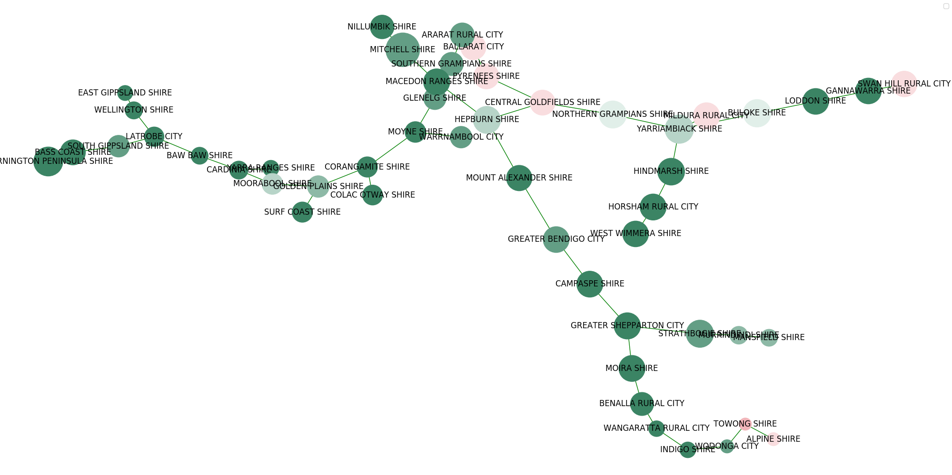
/mnt/y/Code/Analysis/graph/Graph_figures/VIC_LGA/present/season/size_prod_color_VF_time_2013_1.png

Slide 3
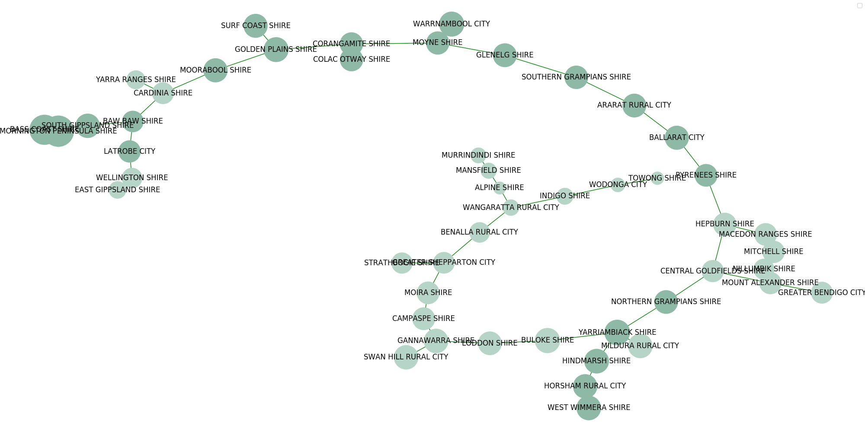
/mnt/y/Code/Analysis/graph/Graph_figures/VIC_LGA/present/season/size_prod_color_VF_time_2013_10.png

Slide 4
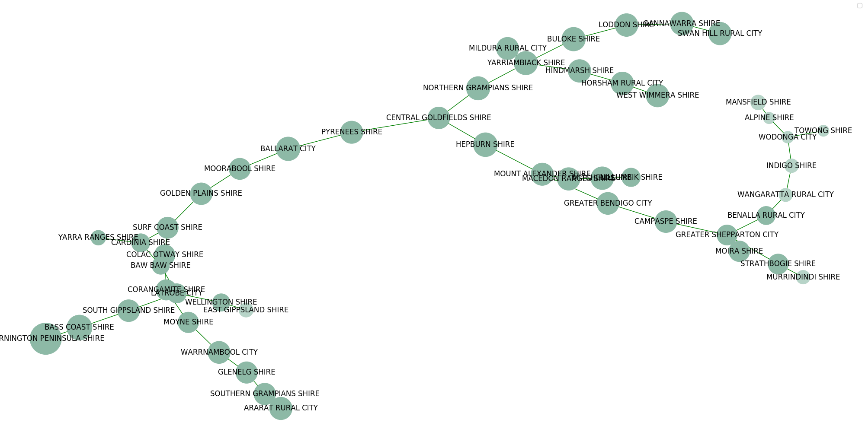
/mnt/y/Code/Analysis/graph/Graph_figures/VIC_LGA/present/season/size_prod_color_VF_time_2013_11.png

Slide 5
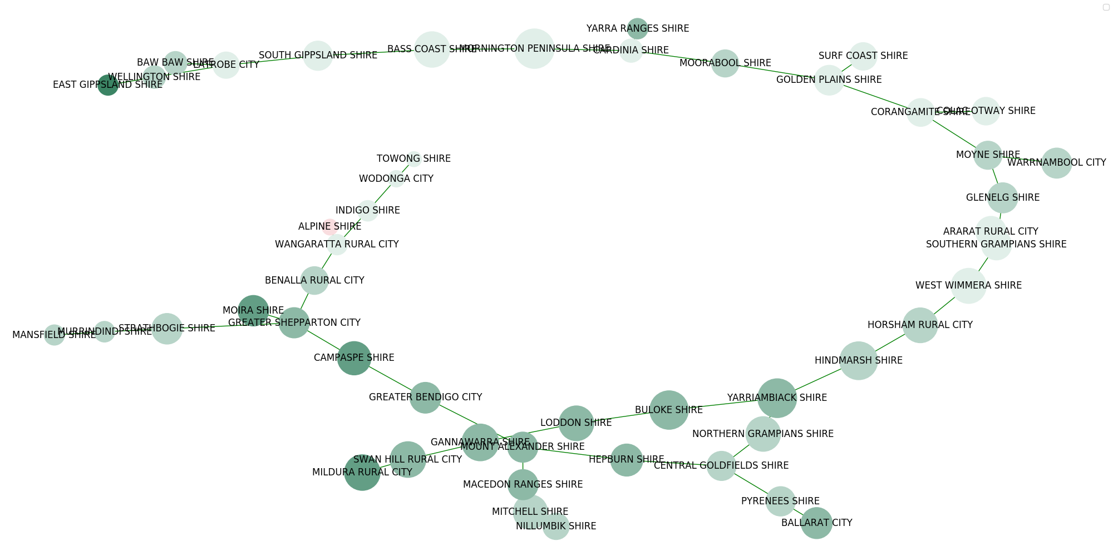
/mnt/y/Code/Analysis/graph/Graph_figures/VIC_LGA/present/season/size_prod_color_VF_time_2013_12.png

Slide 6
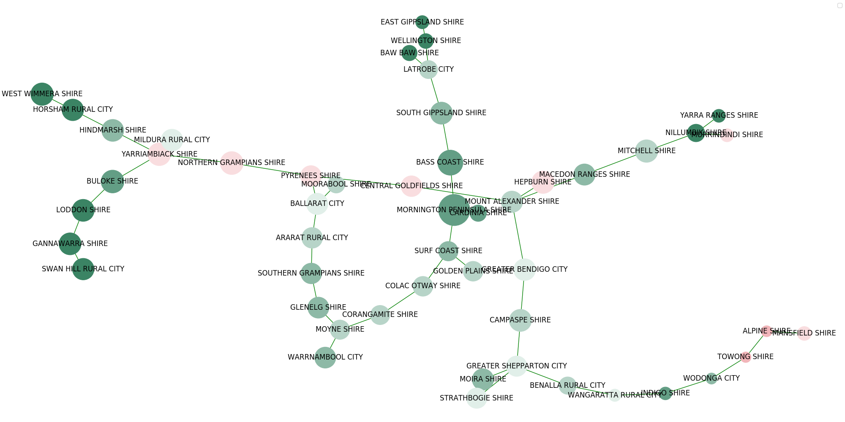
/mnt/y/Code/Analysis/graph/Graph_figures/VIC_LGA/present/season/size_prod_color_VF_time_2013_2.png

Slide 7
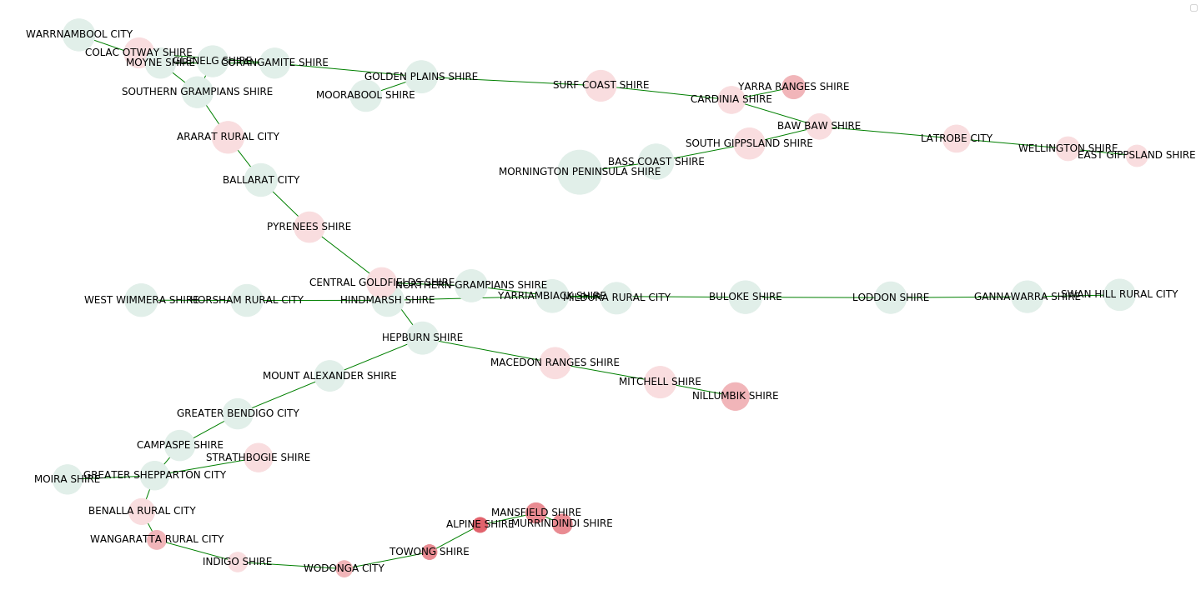
/mnt/y/Code/Analysis/graph/Graph_figures/VIC_LGA/present/season/size_prod_color_VF_time_2013_2017.png

Slide 8
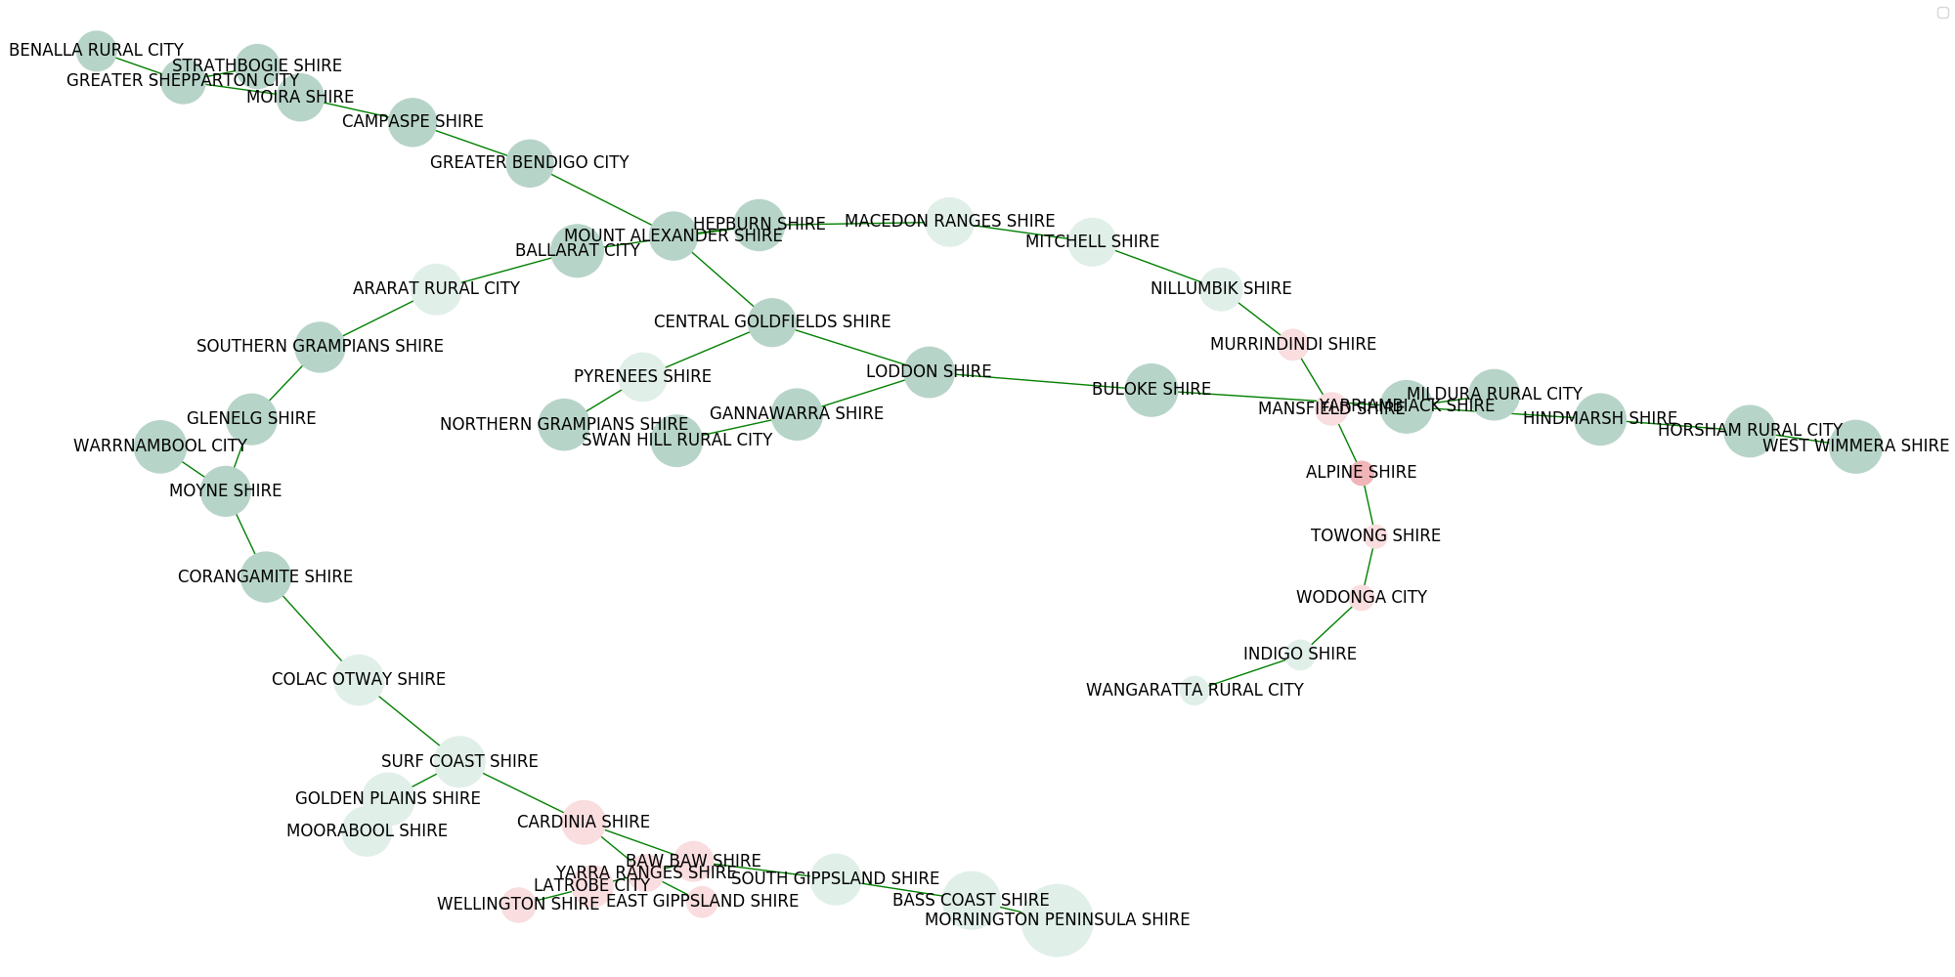
/mnt/y/Code/Analysis/graph/Graph_figures/VIC_LGA/present/season/size_prod_color_VF_time_2013_3.png

Slide 9
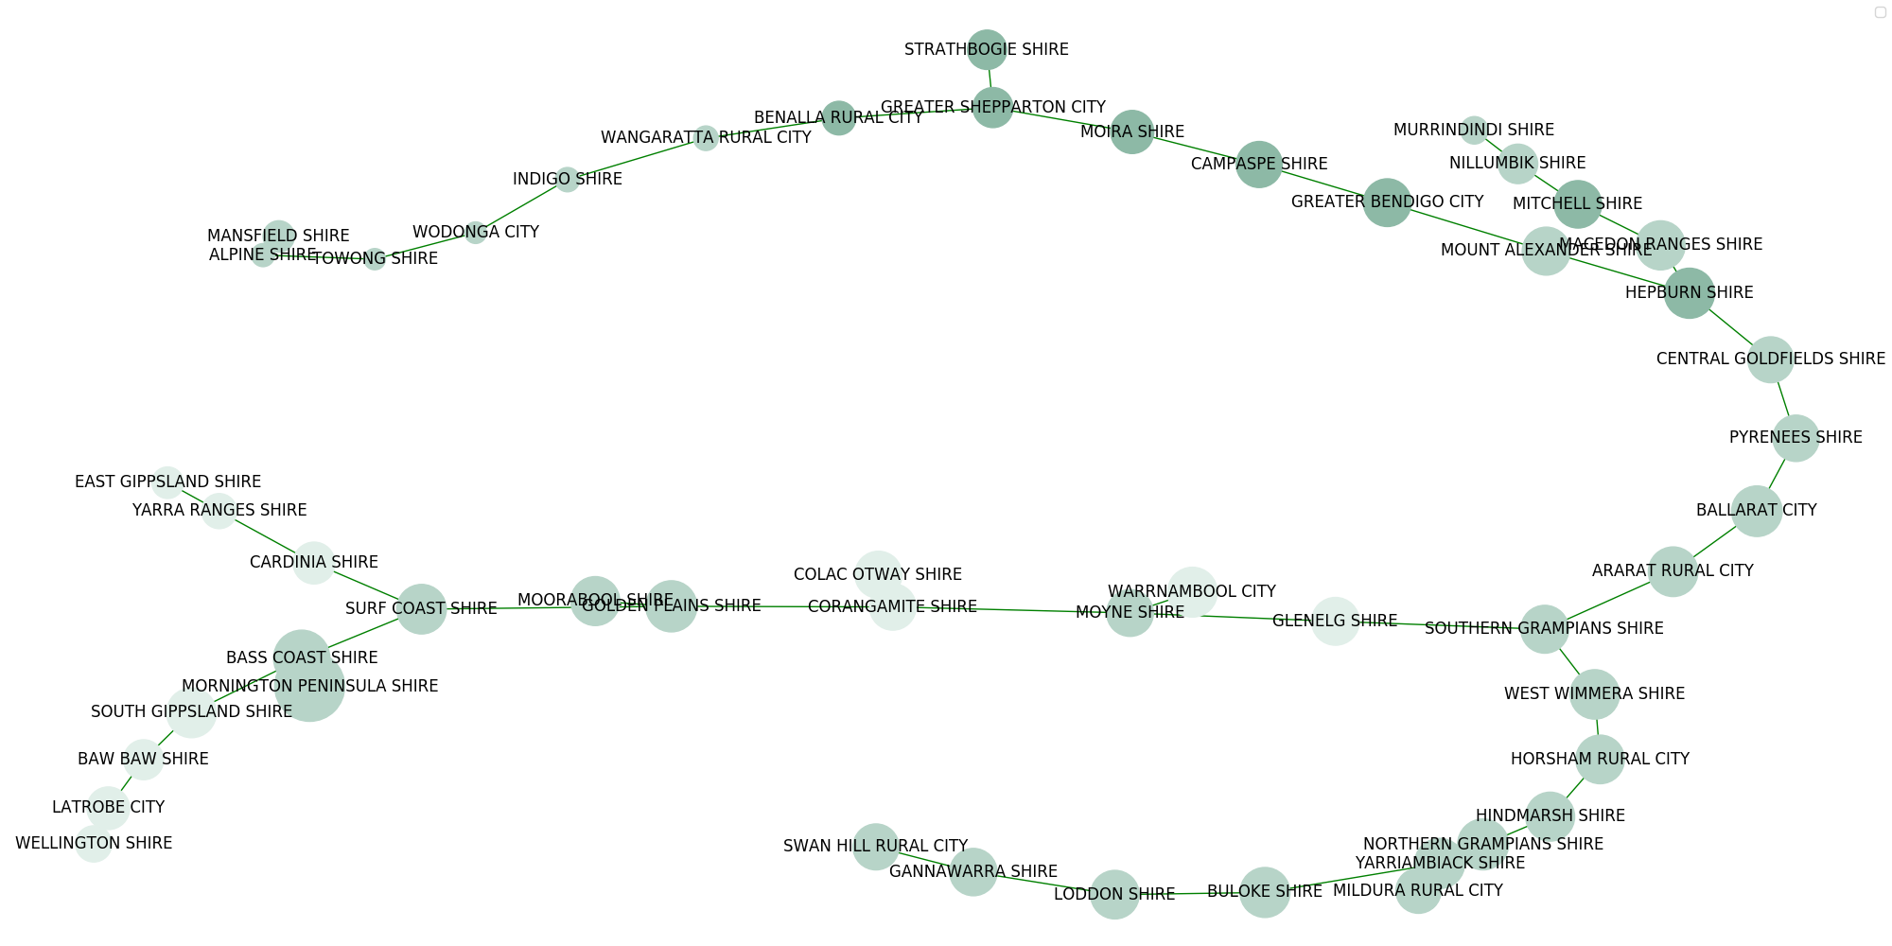
/mnt/y/Code/Analysis/graph/Graph_figures/VIC_LGA/present/season/size_prod_color_VF_time_2013_4.png

Slide 10
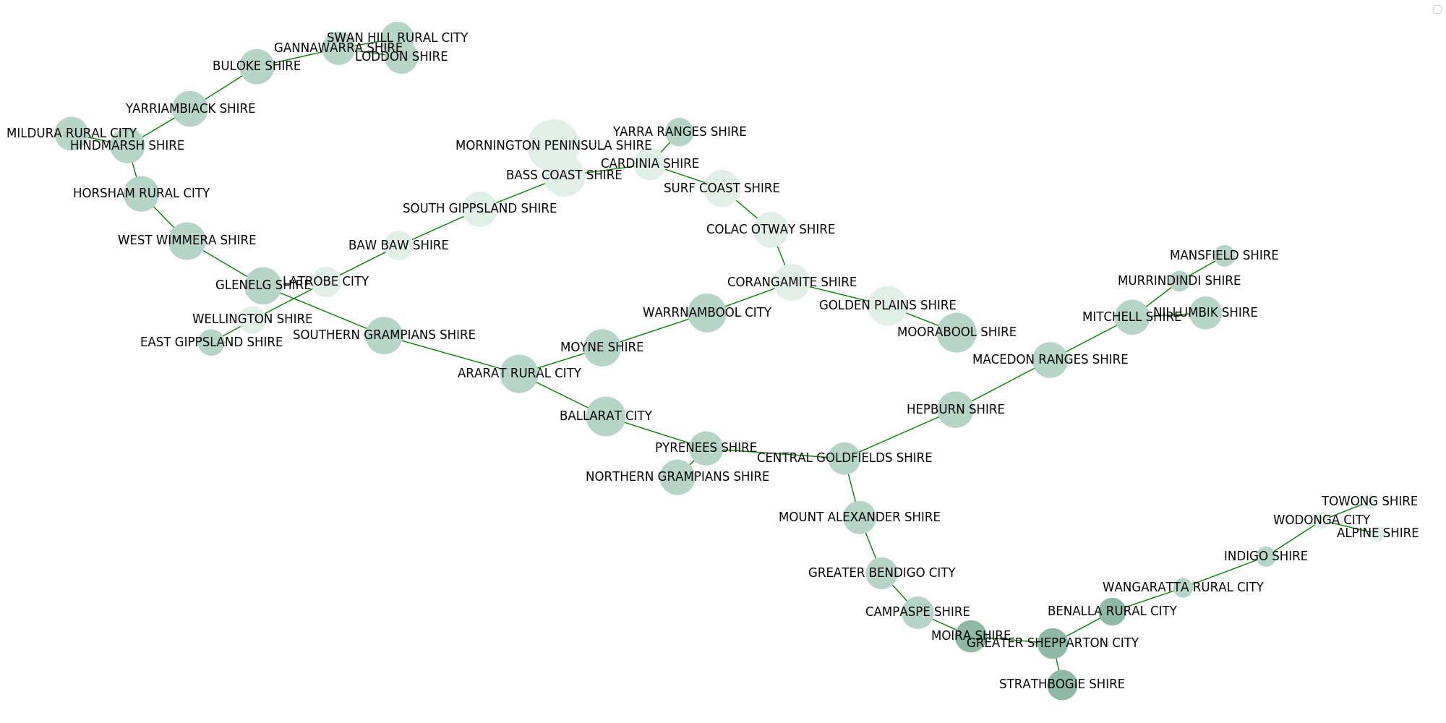
/mnt/y/Code/Analysis/graph/Graph_figures/VIC_LGA/present/season/size_prod_color_VF_time_2013_5.png

Slide 11
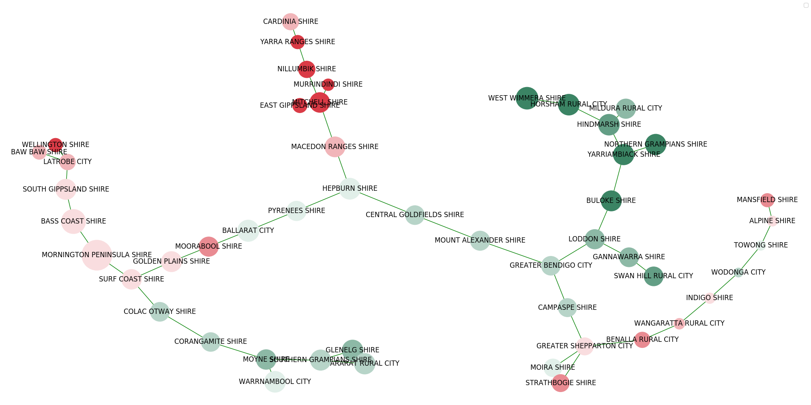
/mnt/y/Code/Analysis/graph/Graph_figures/VIC_LGA/present/season/size_prod_color_VF_time_2013_6.png

Slide 12
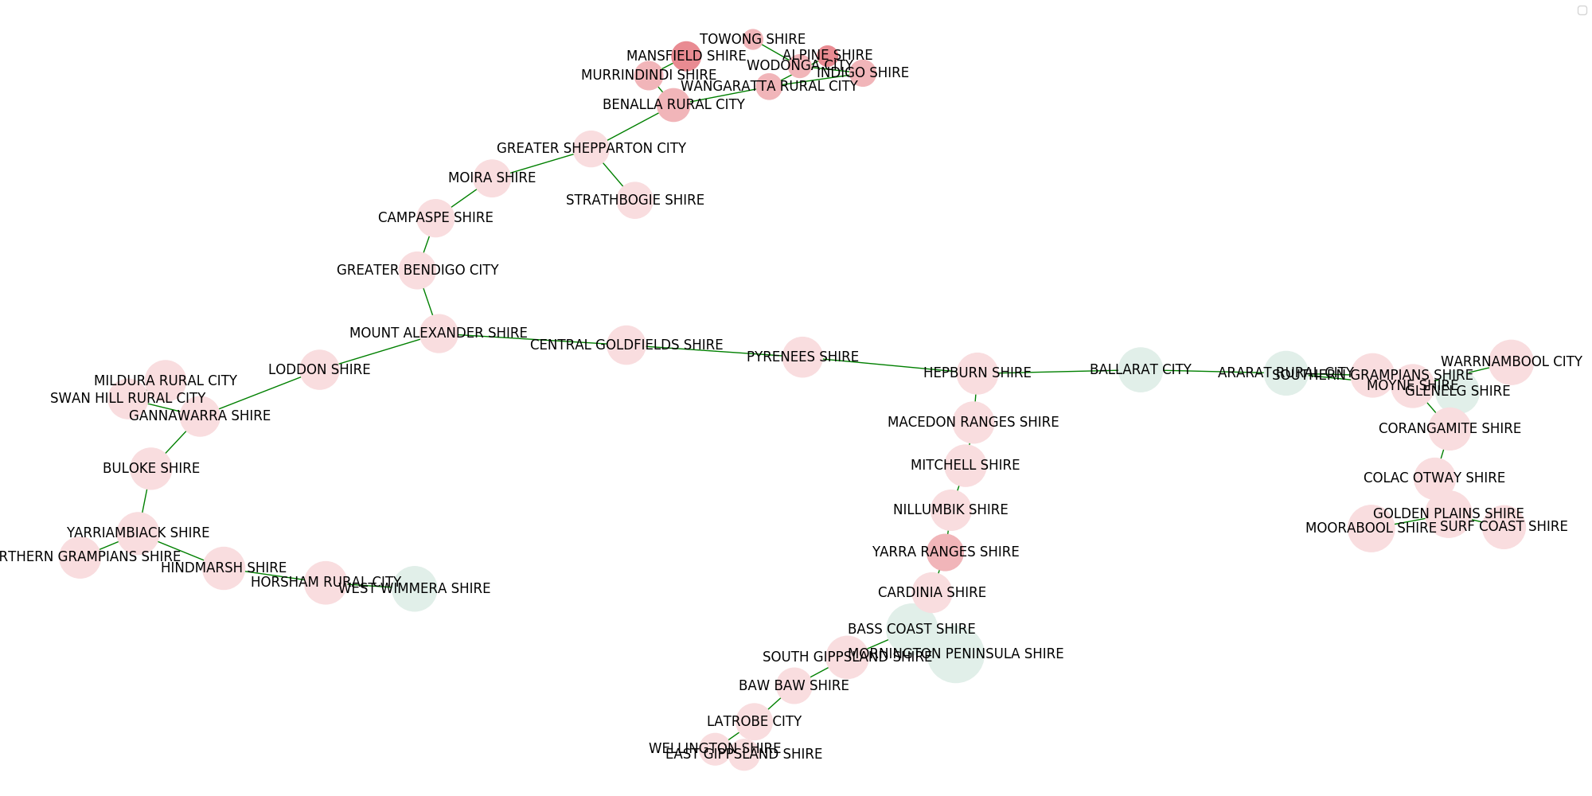
/mnt/y/Code/Analysis/graph/Graph_figures/VIC_LGA/present/season/size_prod_color_VF_time_2013_7.png

Slide 13
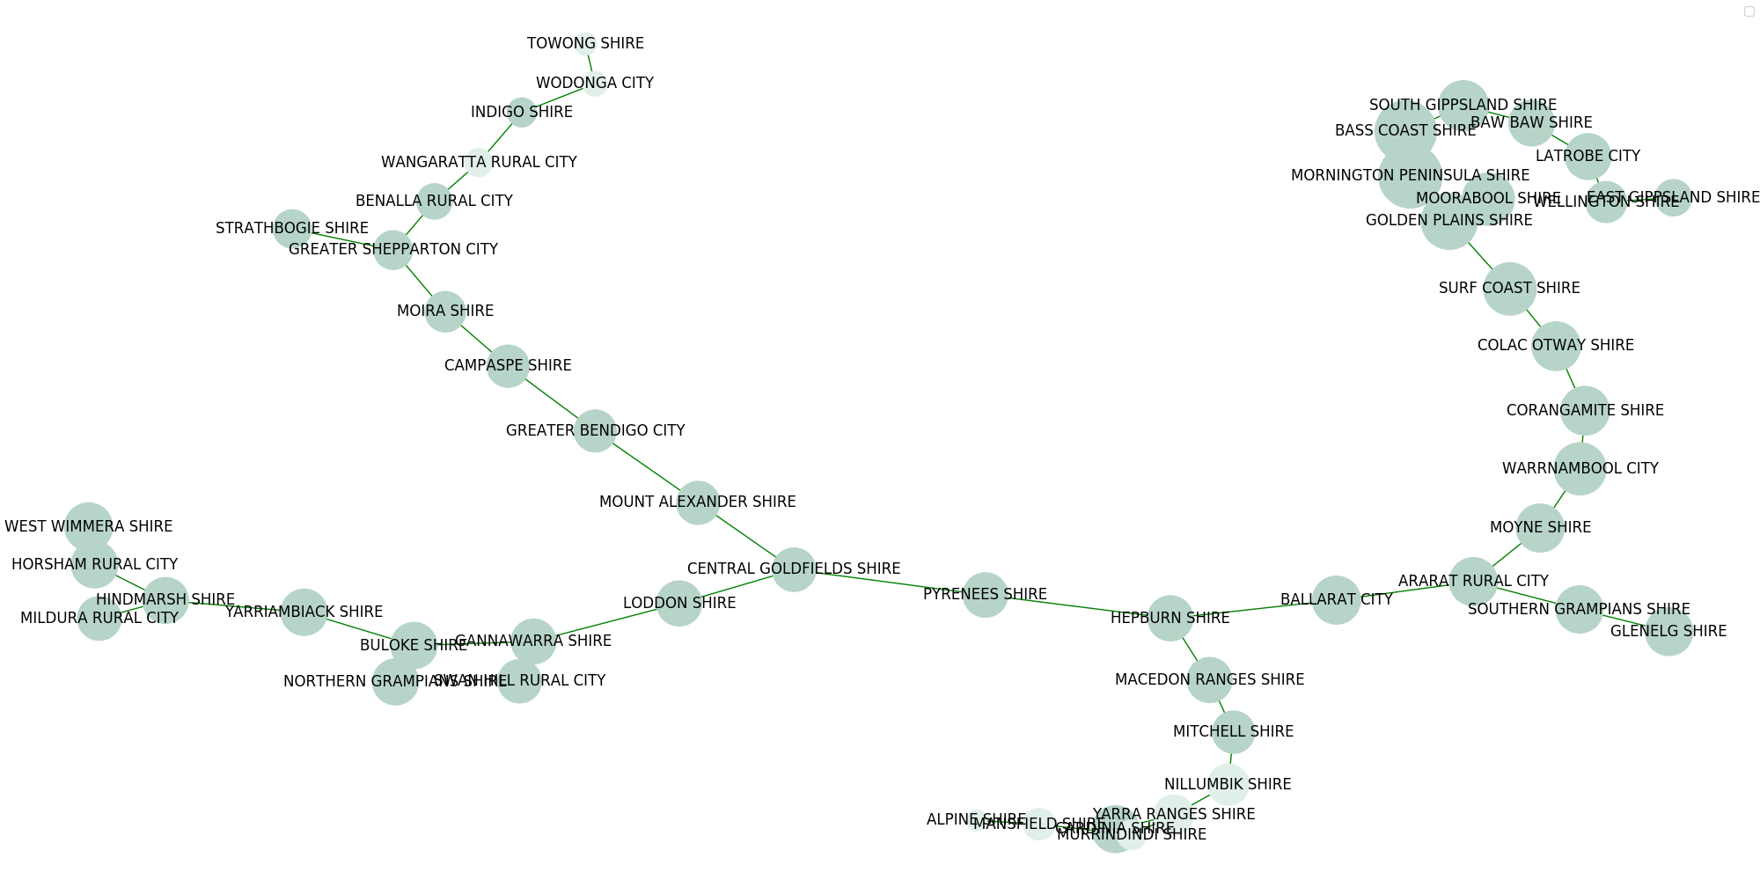
/mnt/y/Code/Analysis/graph/Graph_figures/VIC_LGA/present/season/size_prod_color_VF_time_2013_8.png

Slide 14
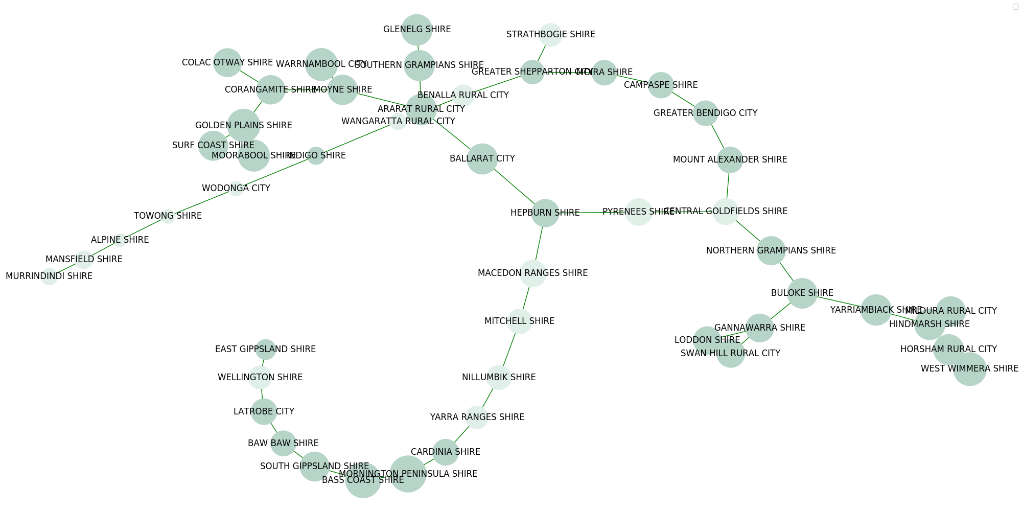
/mnt/y/Code/Analysis/graph/Graph_figures/VIC_LGA/present/season/size_prod_color_VF_time_2013_9.png

Slide 15
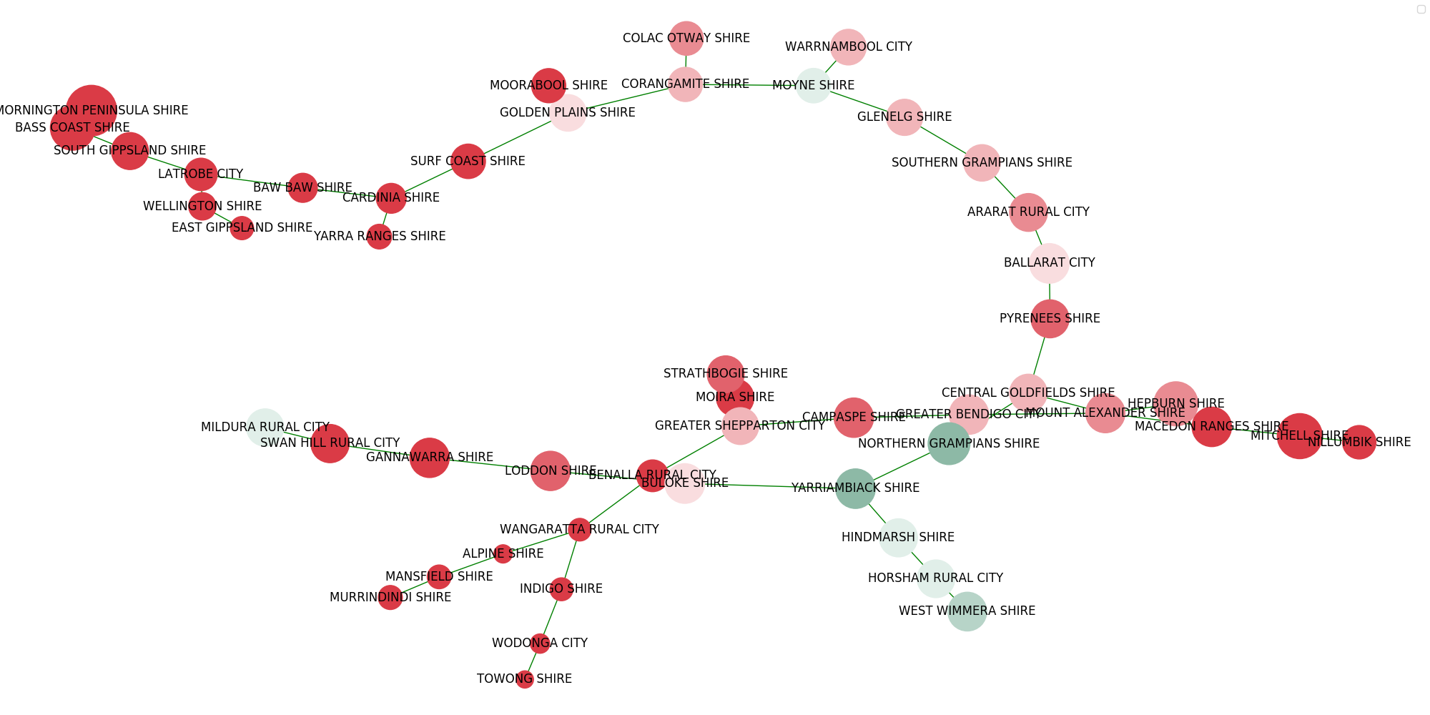
/mnt/y/Code/Analysis/graph/Graph_figures/VIC_LGA/present/season/size_prod_color_VF_time_2014_1.png

Slide 16
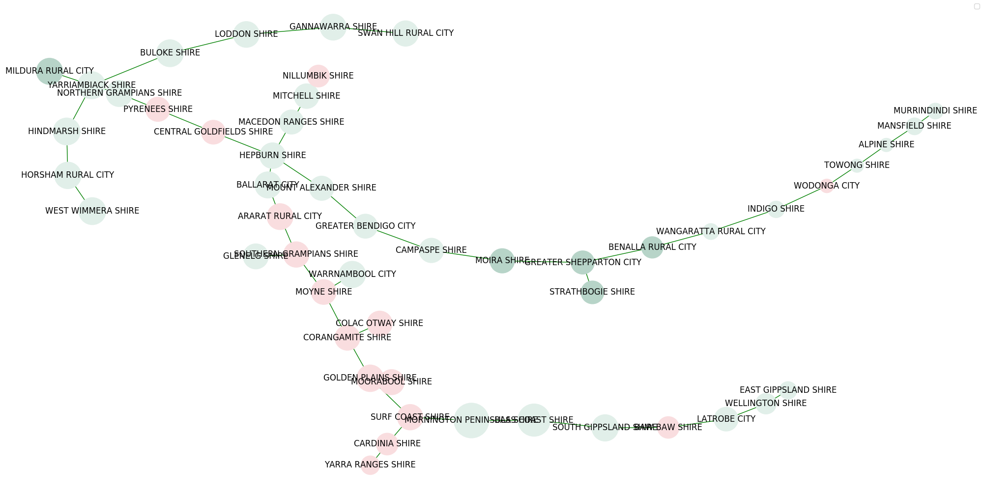
/mnt/y/Code/Analysis/graph/Graph_figures/VIC_LGA/present/season/size_prod_color_VF_time_2014_10.png

Slide 17
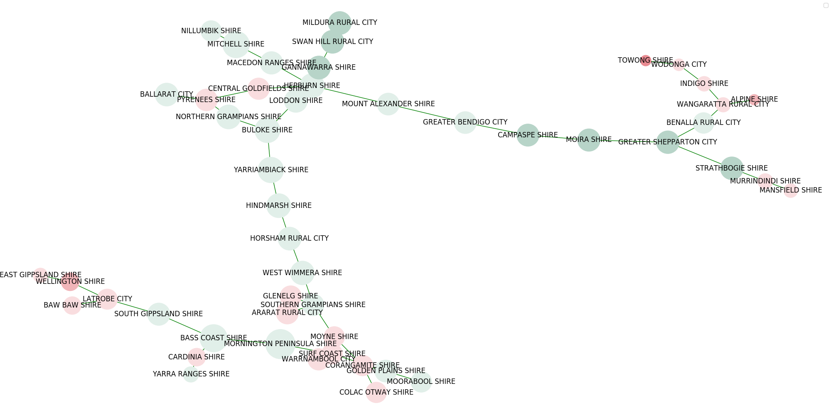
/mnt/y/Code/Analysis/graph/Graph_figures/VIC_LGA/present/season/size_prod_color_VF_time_2014_11.png

Slide 18
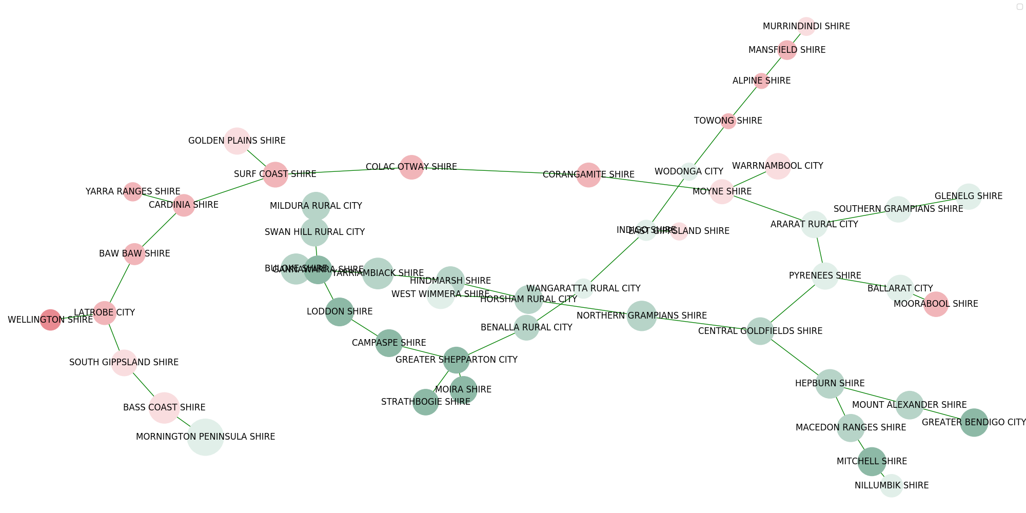
/mnt/y/Code/Analysis/graph/Graph_figures/VIC_LGA/present/season/size_prod_color_VF_time_2014_12.png

Slide 19
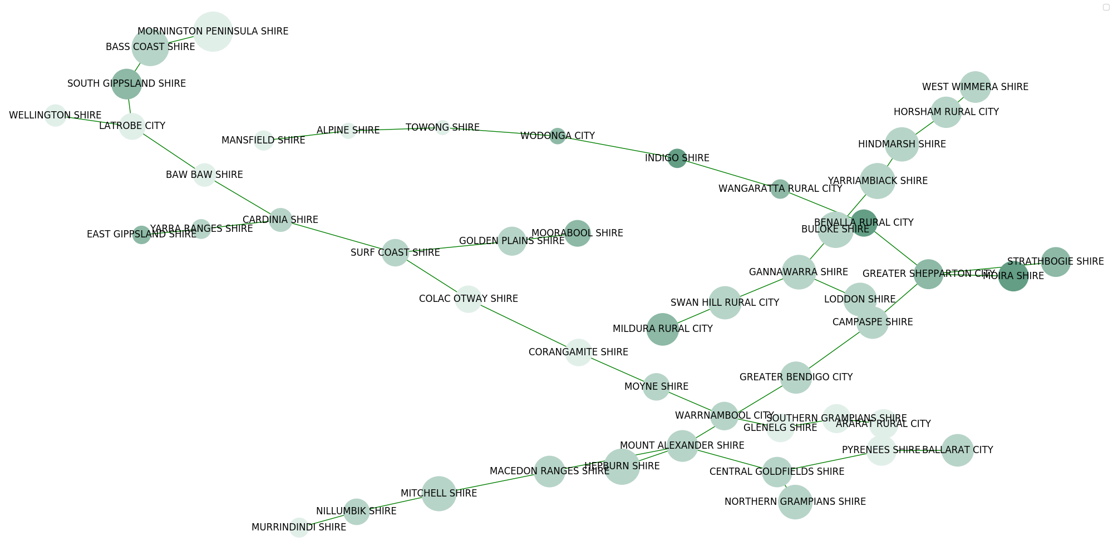
/mnt/y/Code/Analysis/graph/Graph_figures/VIC_LGA/present/season/size_prod_color_VF_time_2014_2.png

Slide 20
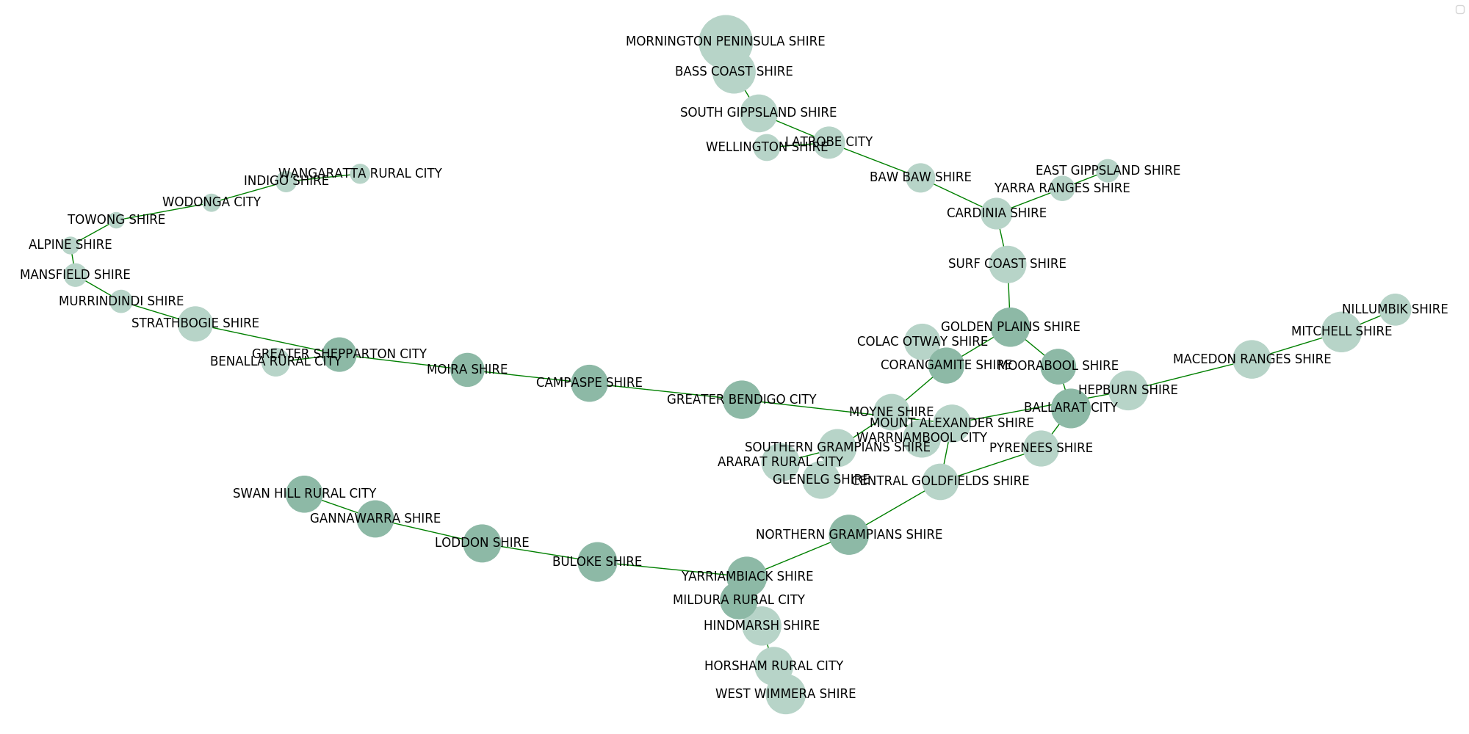
/mnt/y/Code/Analysis/graph/Graph_figures/VIC_LGA/present/season/size_prod_color_VF_time_2014_3.png

Slide 21
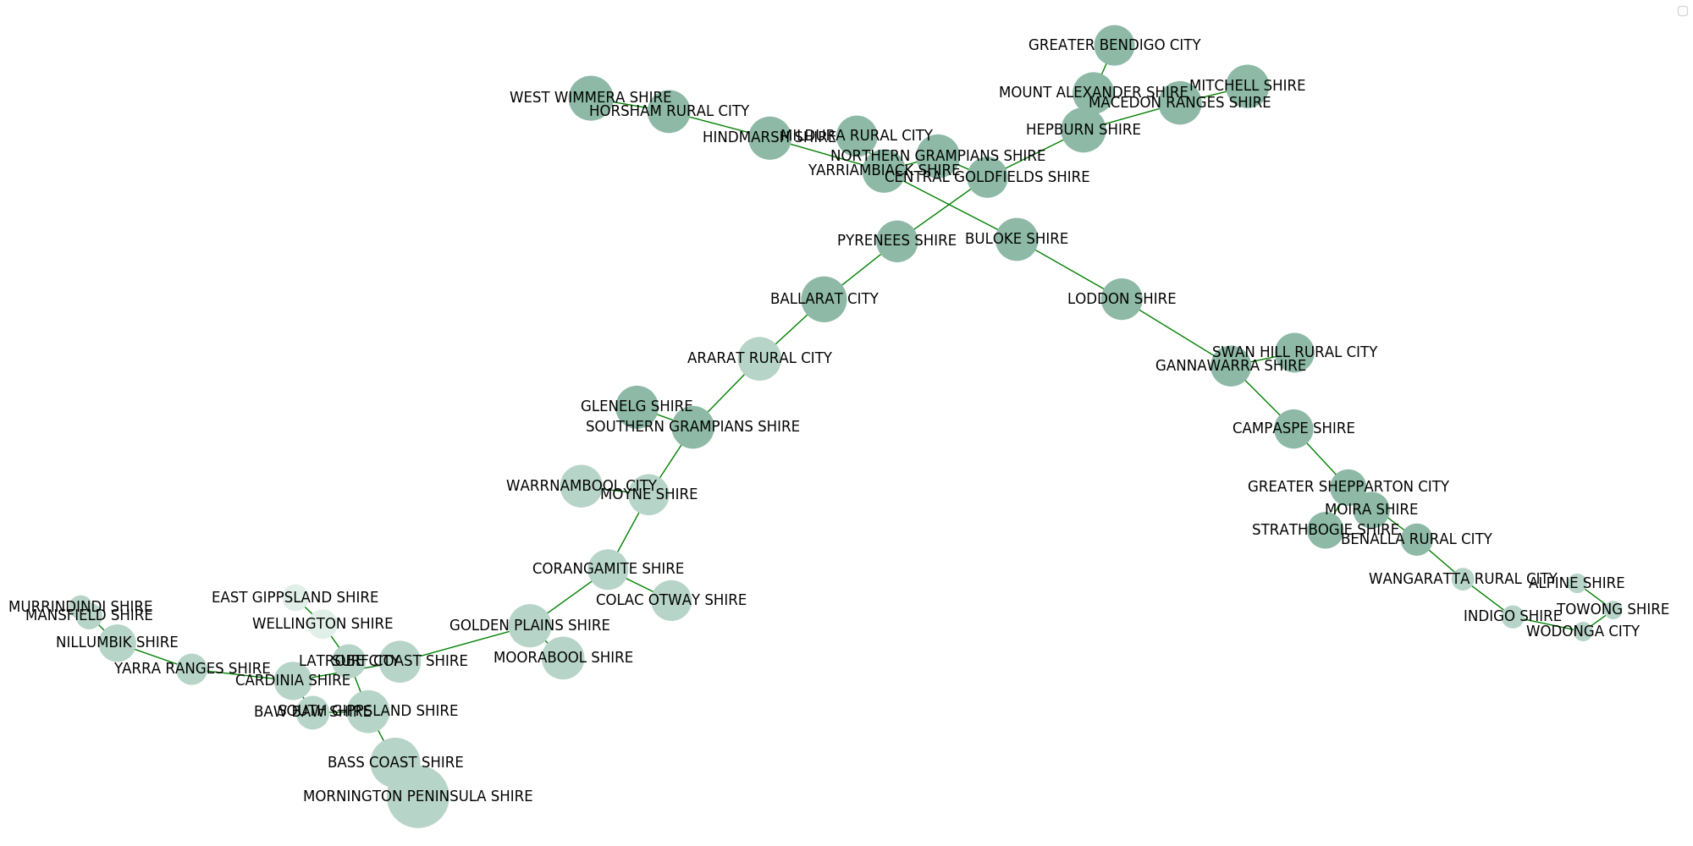
/mnt/y/Code/Analysis/graph/Graph_figures/VIC_LGA/present/season/size_prod_color_VF_time_2014_4.png

Slide 22
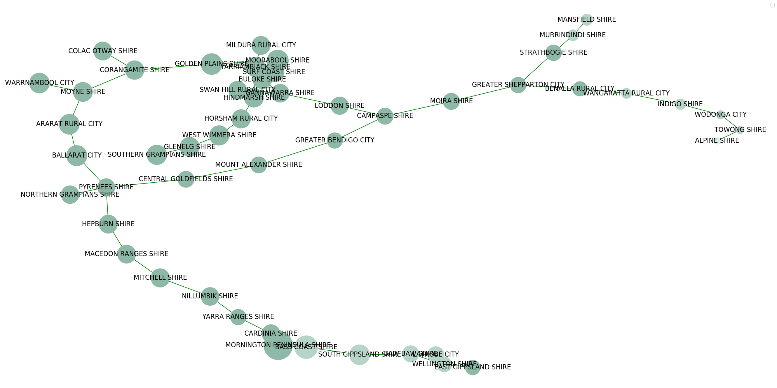
/mnt/y/Code/Analysis/graph/Graph_figures/VIC_LGA/present/season/size_prod_color_VF_time_2014_5.png

Slide 23
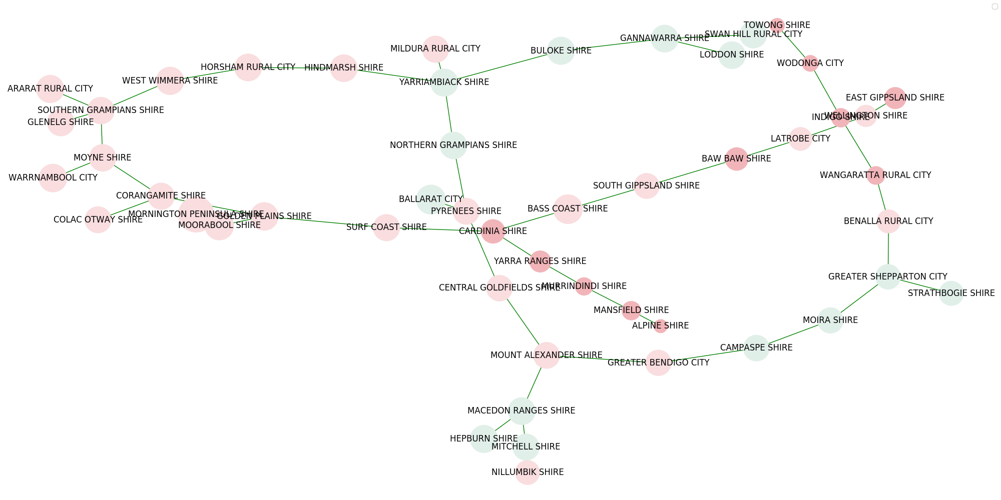
/mnt/y/Code/Analysis/graph/Graph_figures/VIC_LGA/present/season/size_prod_color_VF_time_2014_6.png

Slide 24
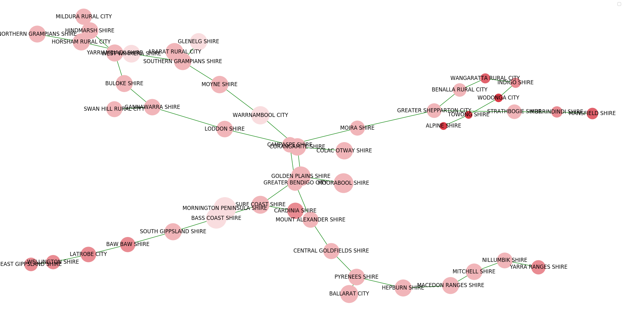
/mnt/y/Code/Analysis/graph/Graph_figures/VIC_LGA/present/season/size_prod_color_VF_time_2014_7.png

Slide 25
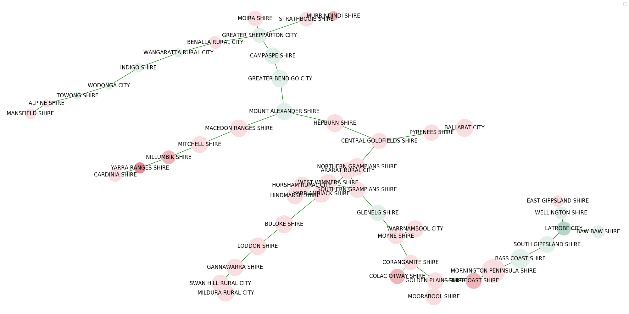
/mnt/y/Code/Analysis/graph/Graph_figures/VIC_LGA/present/season/size_prod_color_VF_time_2014_8.png

Slide 26
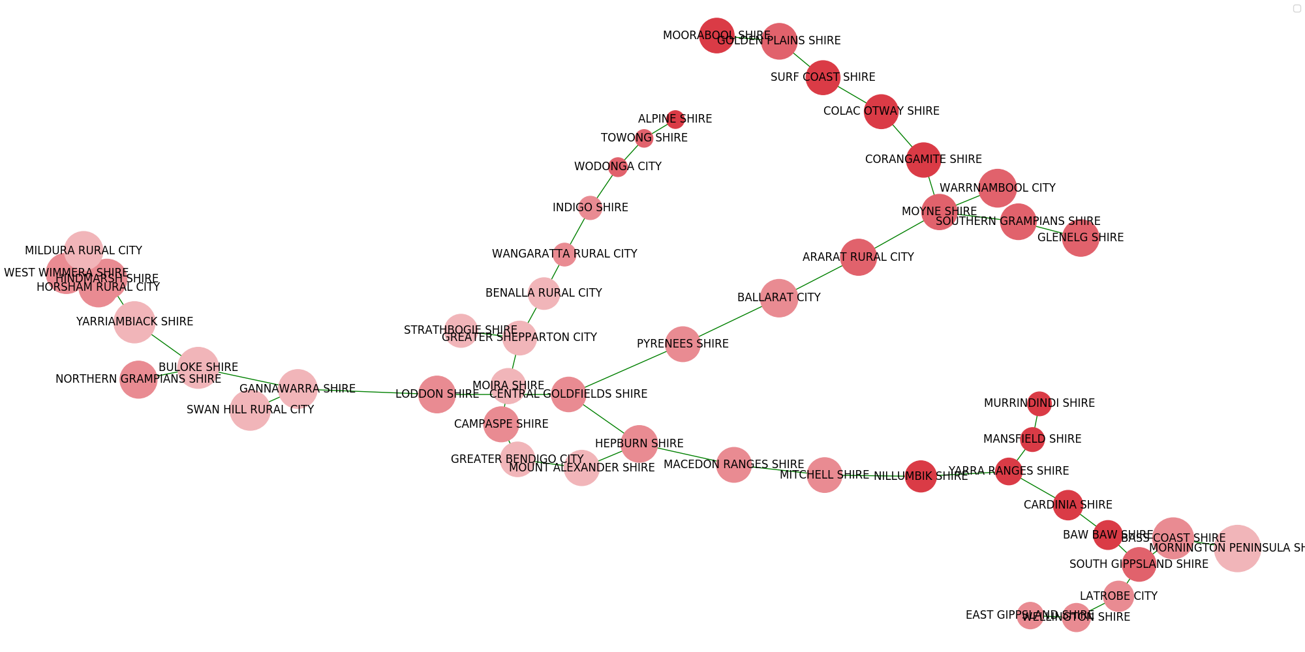
/mnt/y/Code/Analysis/graph/Graph_figures/VIC_LGA/present/season/size_prod_color_VF_time_2014_9.png

Slide 27
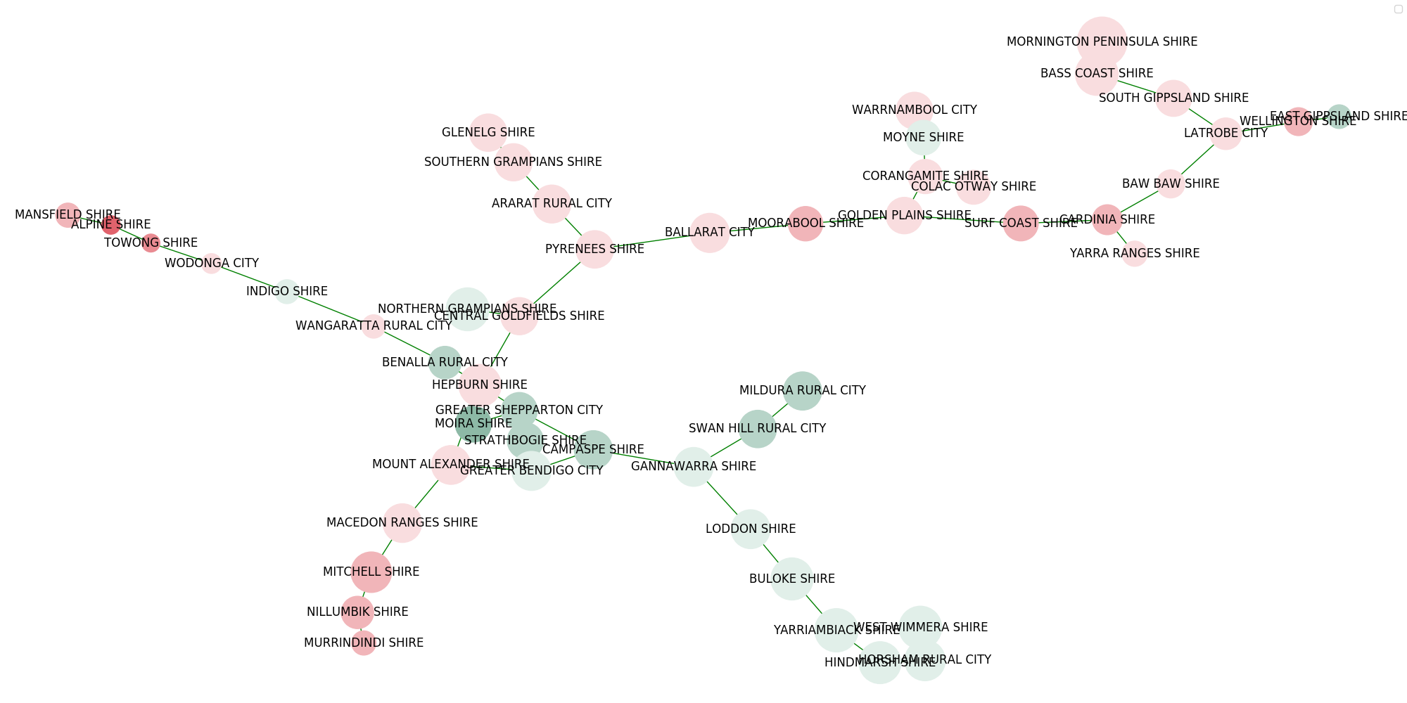
/mnt/y/Code/Analysis/graph/Graph_figures/VIC_LGA/present/season/size_prod_color_VF_time_2015_1.png

Slide 28
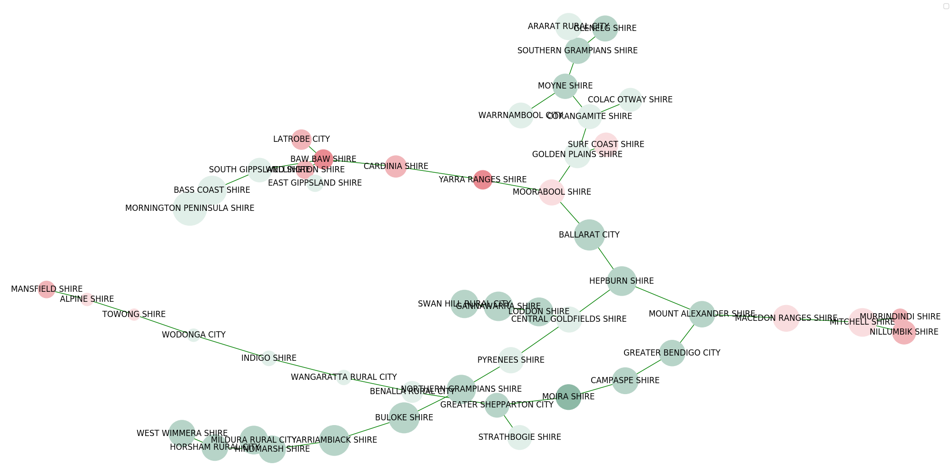
/mnt/y/Code/Analysis/graph/Graph_figures/VIC_LGA/present/season/size_prod_color_VF_time_2015_10.png

Slide 29
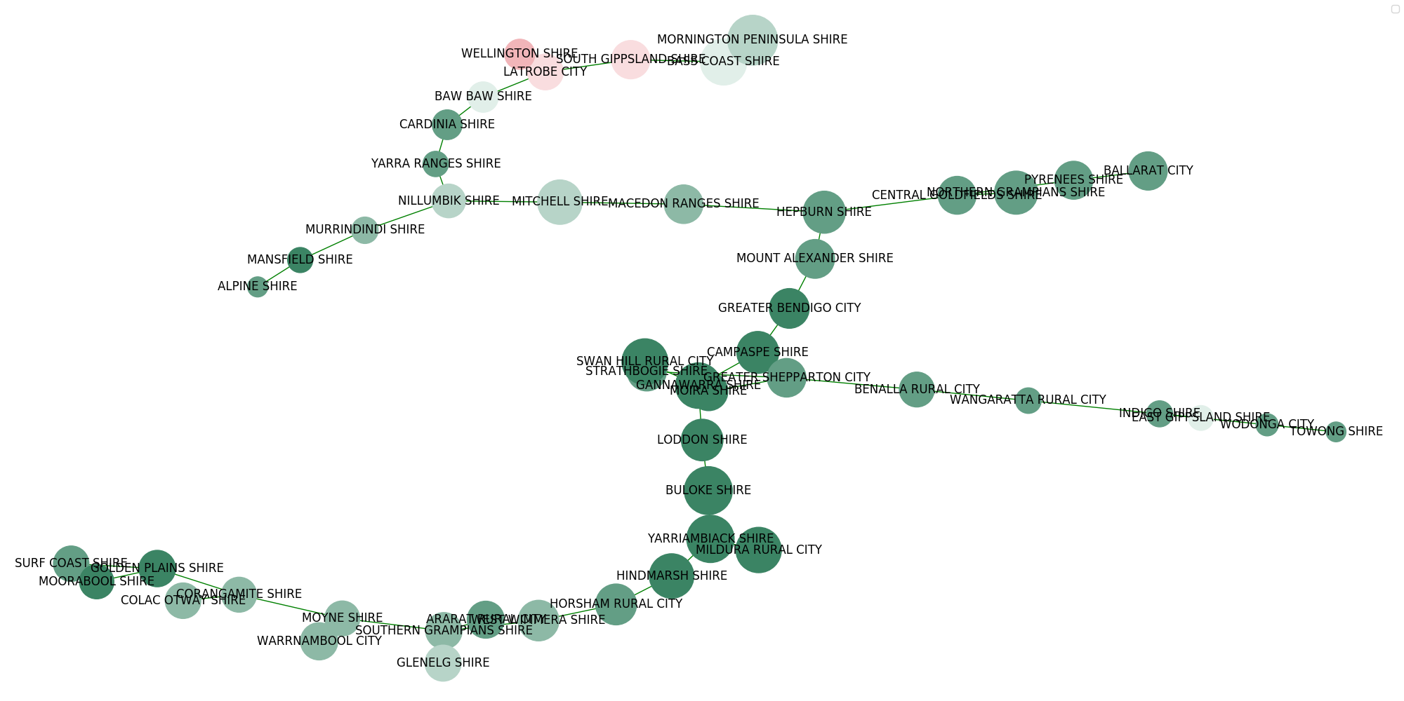
/mnt/y/Code/Analysis/graph/Graph_figures/VIC_LGA/present/season/size_prod_color_VF_time_2015_11.png

Slide 30
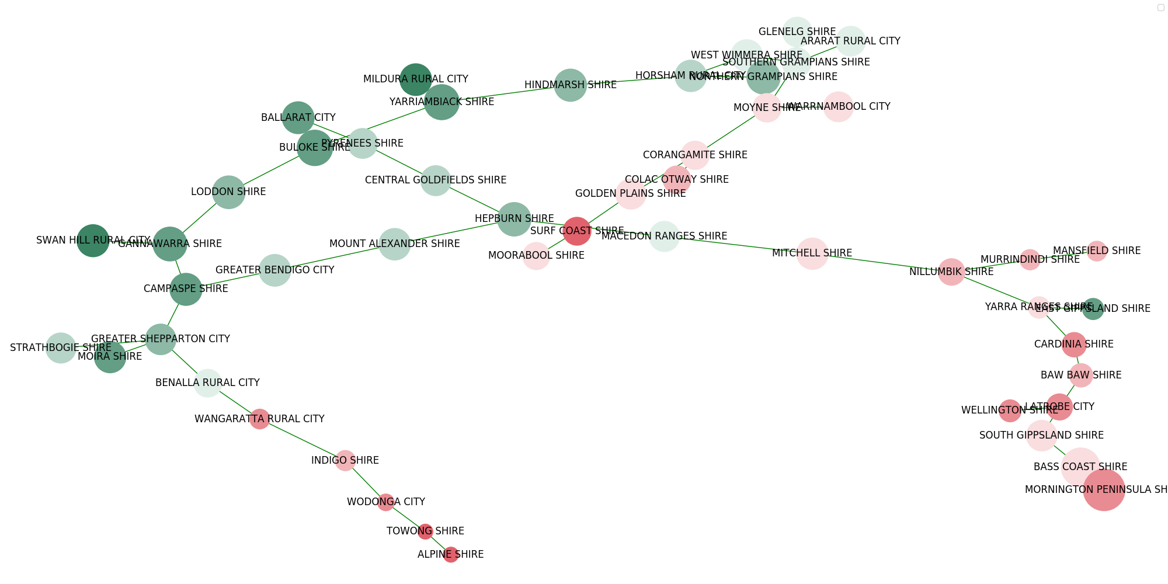
/mnt/y/Code/Analysis/graph/Graph_figures/VIC_LGA/present/season/size_prod_color_VF_time_2015_12.png

Slide 31
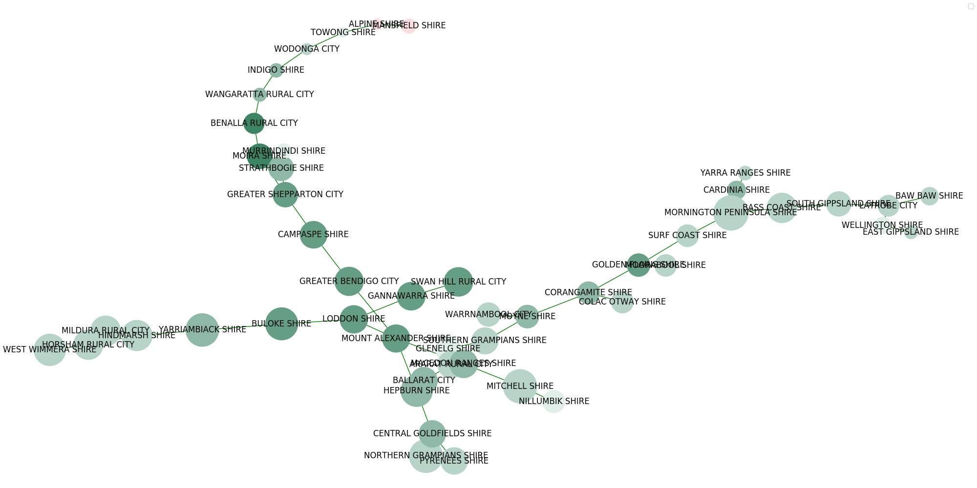
/mnt/y/Code/Analysis/graph/Graph_figures/VIC_LGA/present/season/size_prod_color_VF_time_2015_2.png

Slide 32
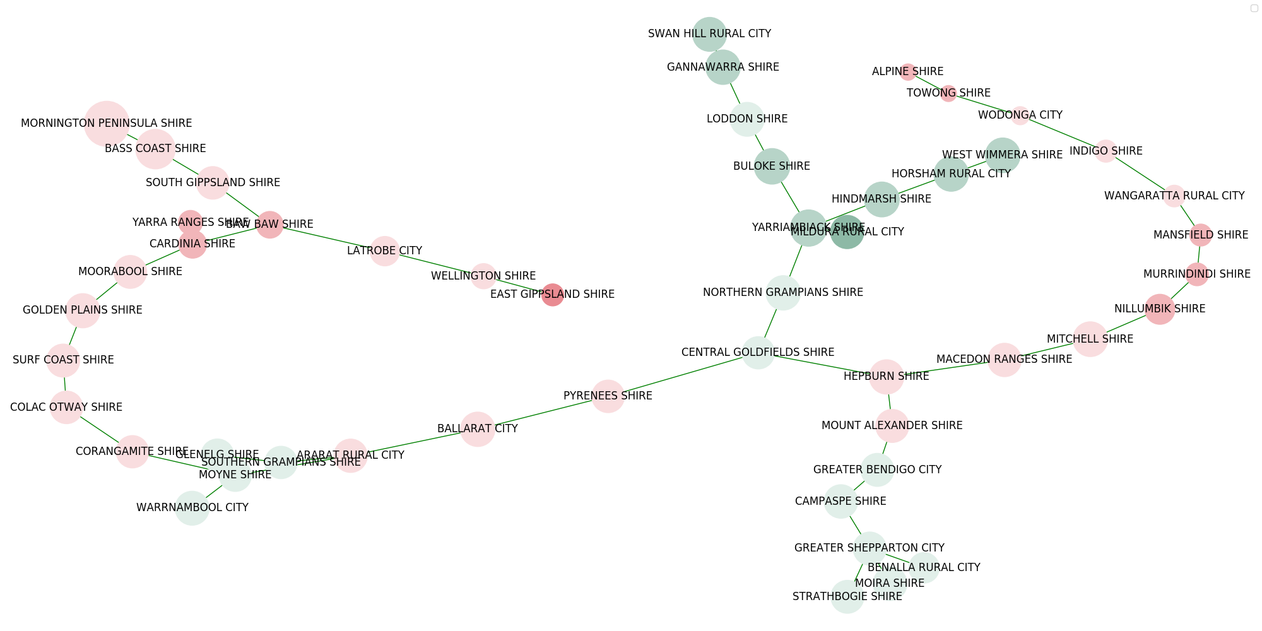
/mnt/y/Code/Analysis/graph/Graph_figures/VIC_LGA/present/season/size_prod_color_VF_time_2015_3.png

Slide 33
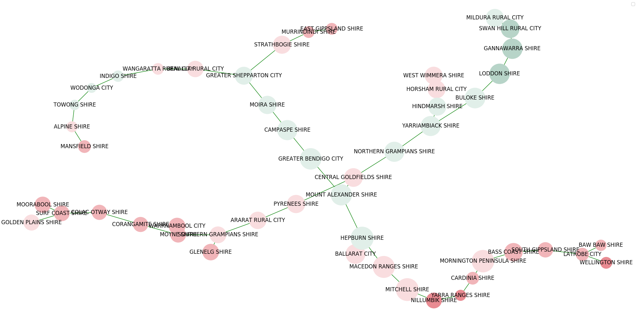
/mnt/y/Code/Analysis/graph/Graph_figures/VIC_LGA/present/season/size_prod_color_VF_time_2015_4.png

Slide 34
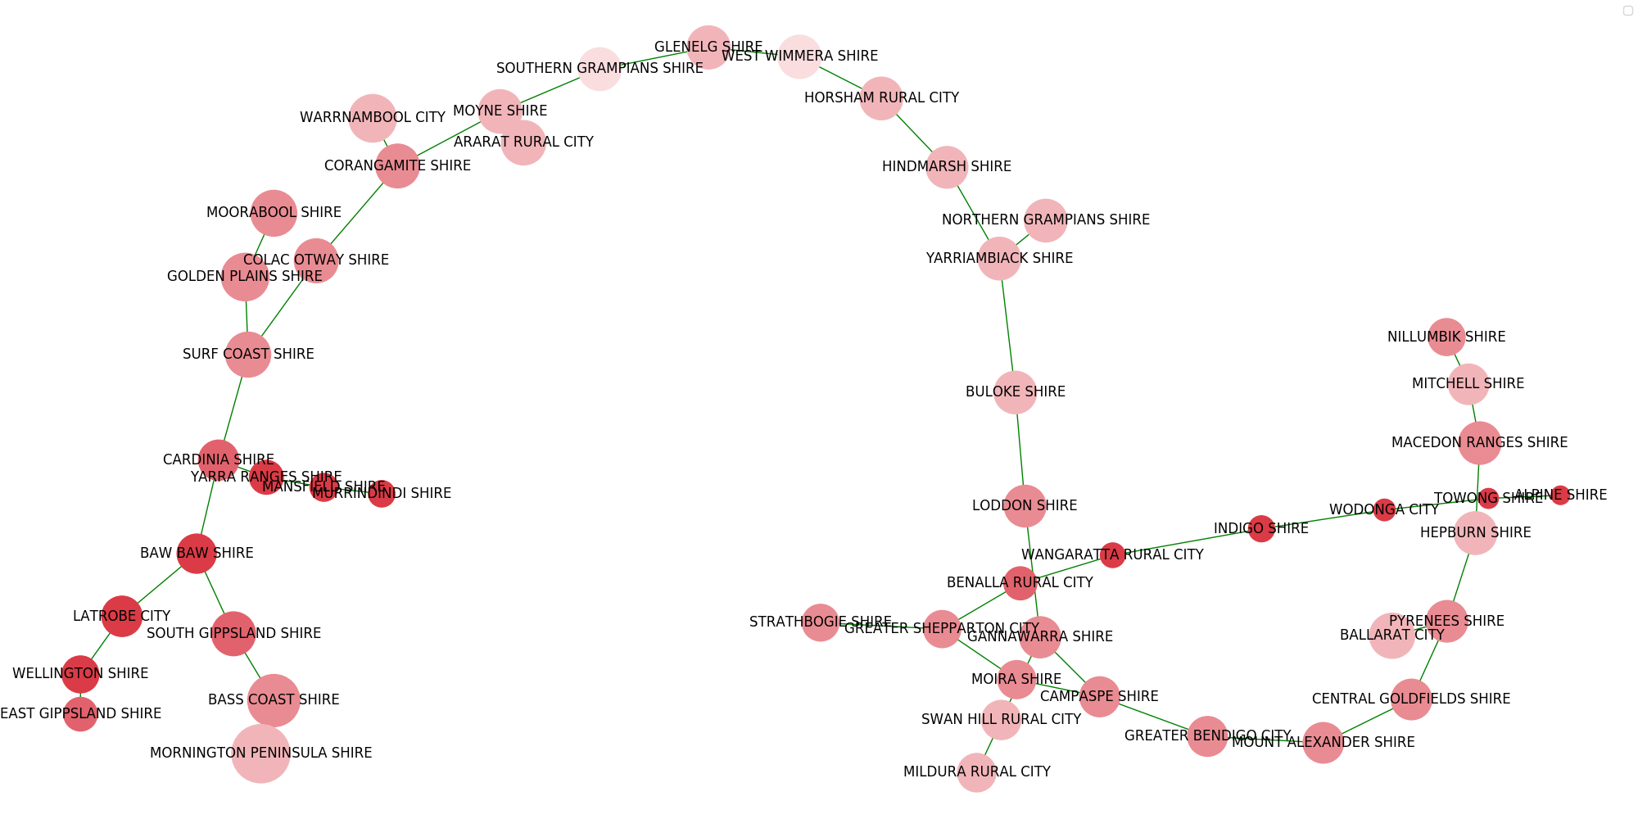
/mnt/y/Code/Analysis/graph/Graph_figures/VIC_LGA/present/season/size_prod_color_VF_time_2015_5.png

Slide 35
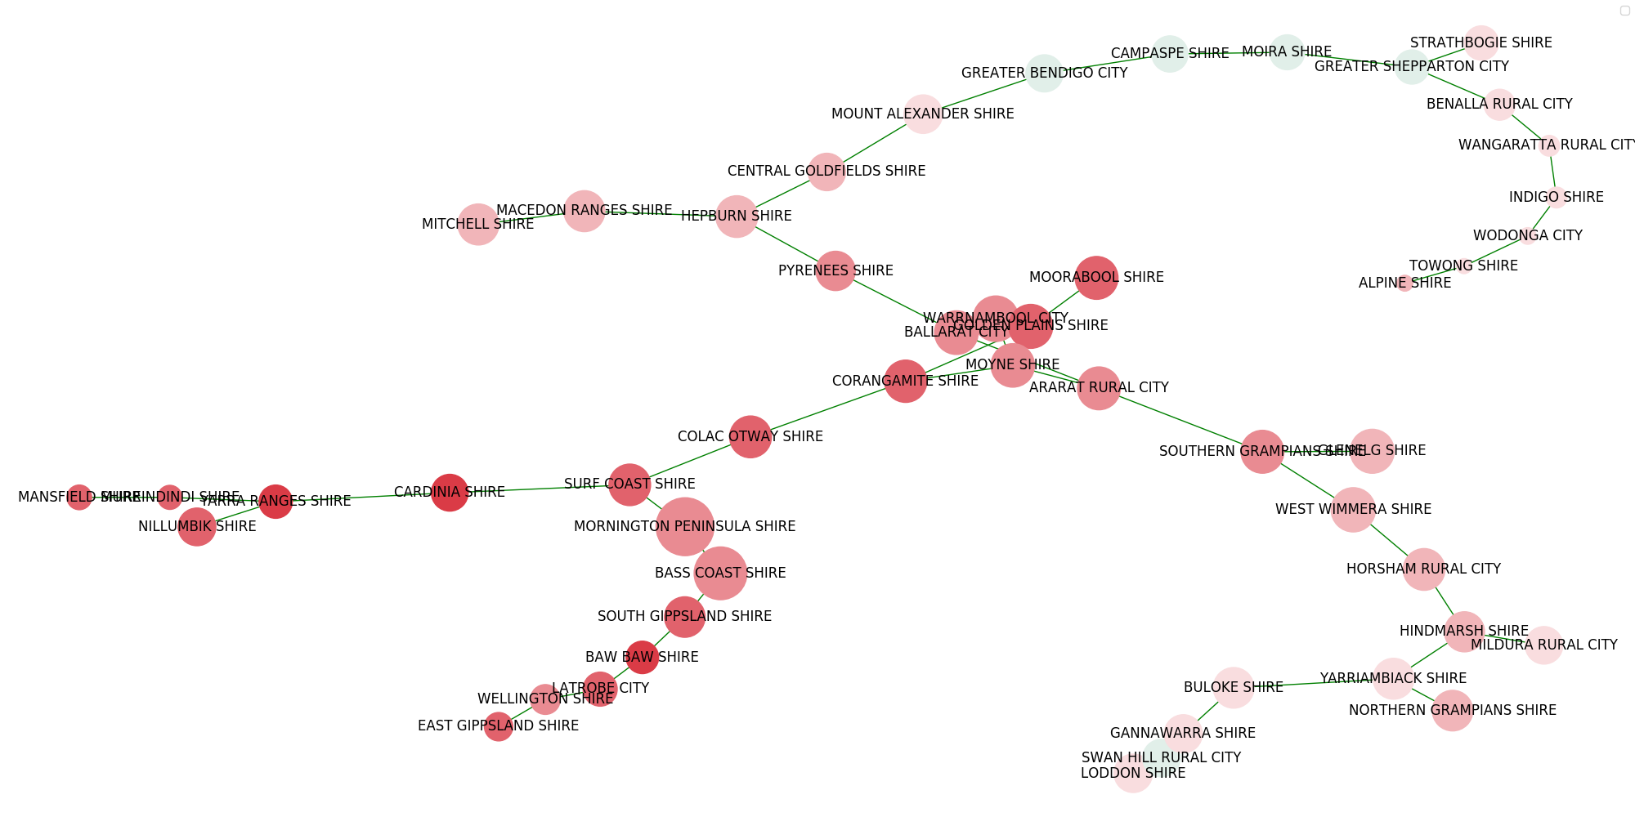
/mnt/y/Code/Analysis/graph/Graph_figures/VIC_LGA/present/season/size_prod_color_VF_time_2015_6.png

Slide 36
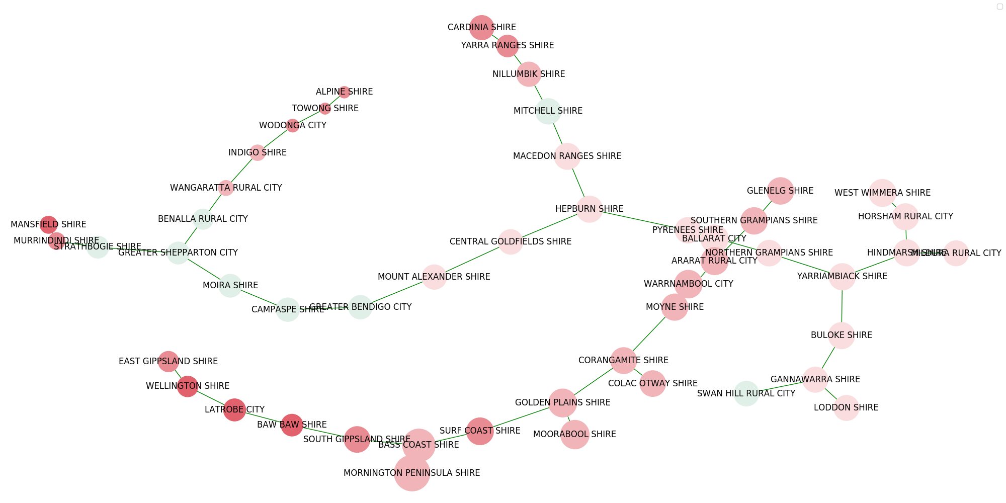
/mnt/y/Code/Analysis/graph/Graph_figures/VIC_LGA/present/season/size_prod_color_VF_time_2015_7.png

Slide 37
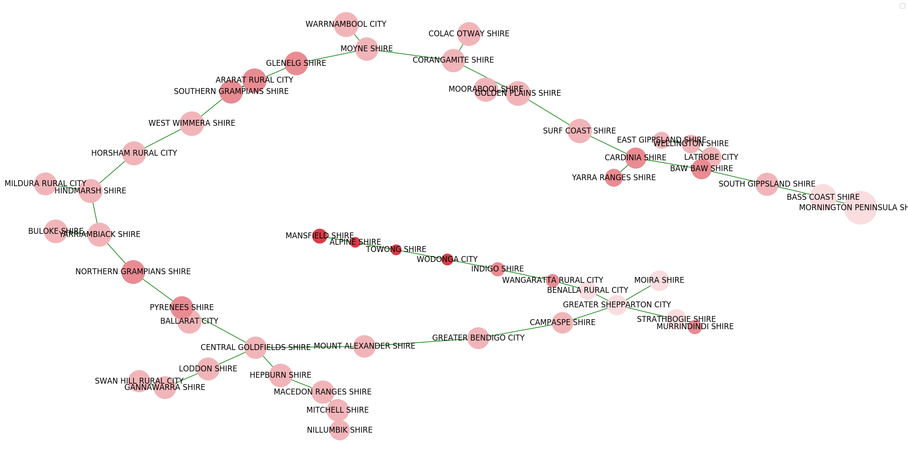
/mnt/y/Code/Analysis/graph/Graph_figures/VIC_LGA/present/season/size_prod_color_VF_time_2015_8.png

Slide 38
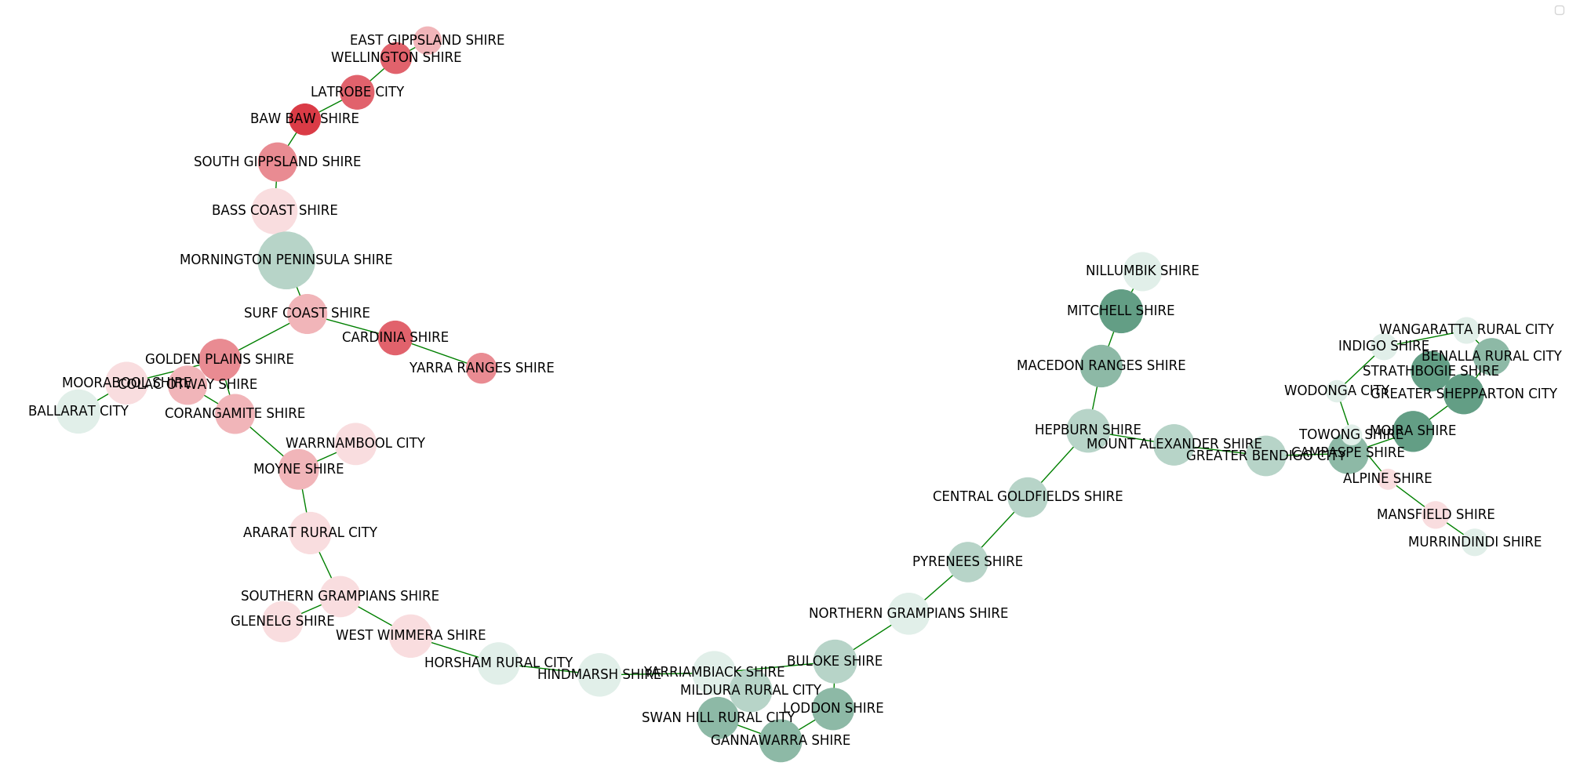
/mnt/y/Code/Analysis/graph/Graph_figures/VIC_LGA/present/season/size_prod_color_VF_time_2015_9.png

Slide 39
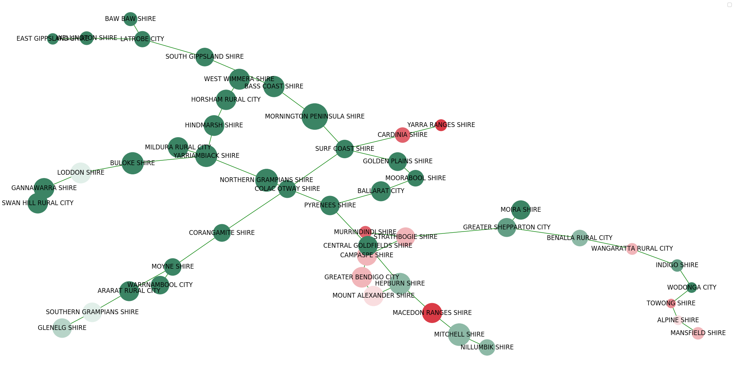
/mnt/y/Code/Analysis/graph/Graph_figures/VIC_LGA/present/season/size_prod_color_VF_time_2016_1.png

Slide 40
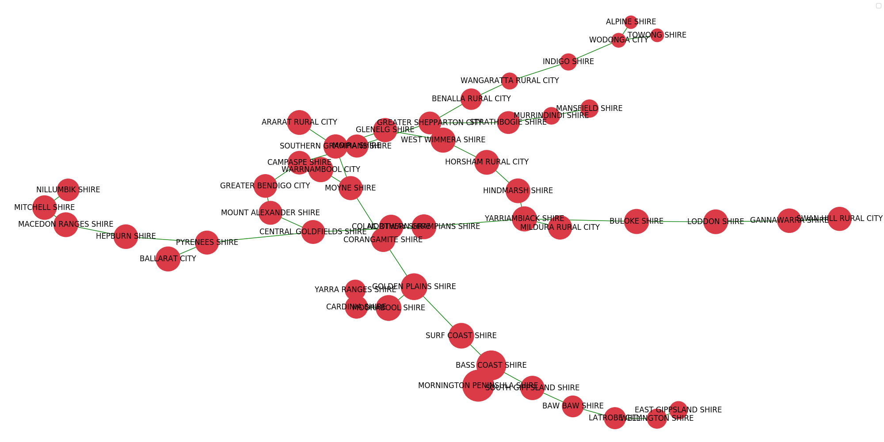
/mnt/y/Code/Analysis/graph/Graph_figures/VIC_LGA/present/season/size_prod_color_VF_time_2016_10.png

Slide 41
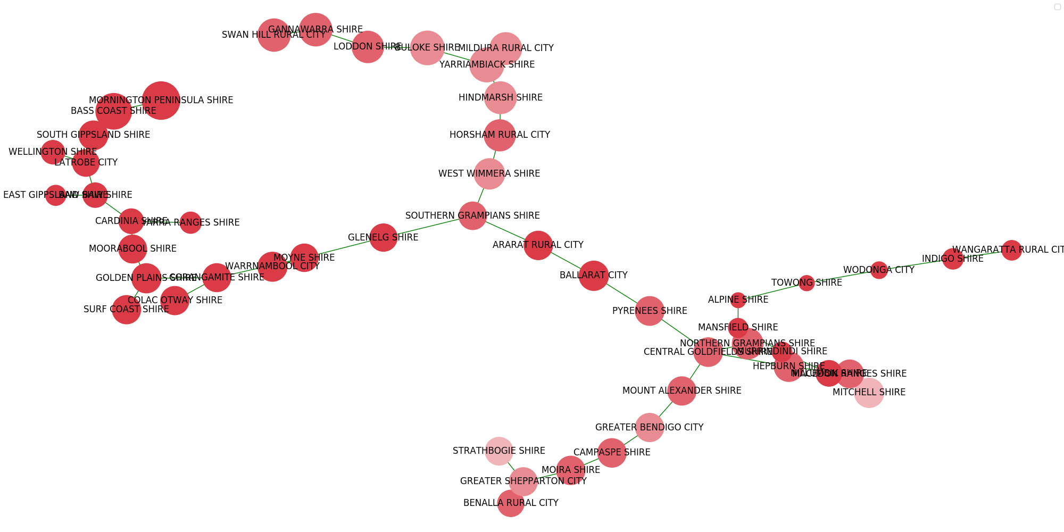
/mnt/y/Code/Analysis/graph/Graph_figures/VIC_LGA/present/season/size_prod_color_VF_time_2016_11.png

Slide 42
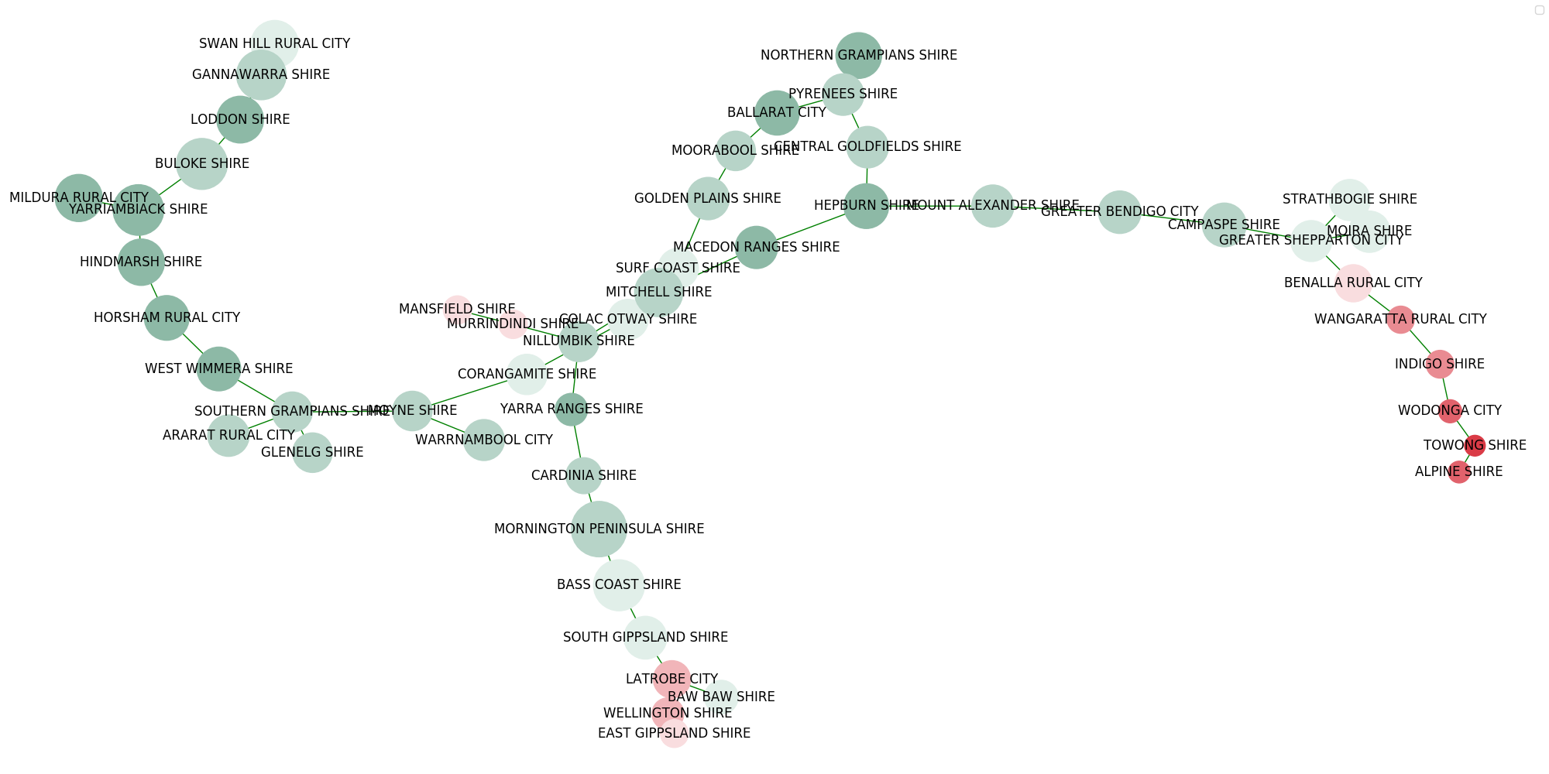
/mnt/y/Code/Analysis/graph/Graph_figures/VIC_LGA/present/season/size_prod_color_VF_time_2016_12.png

Slide 43
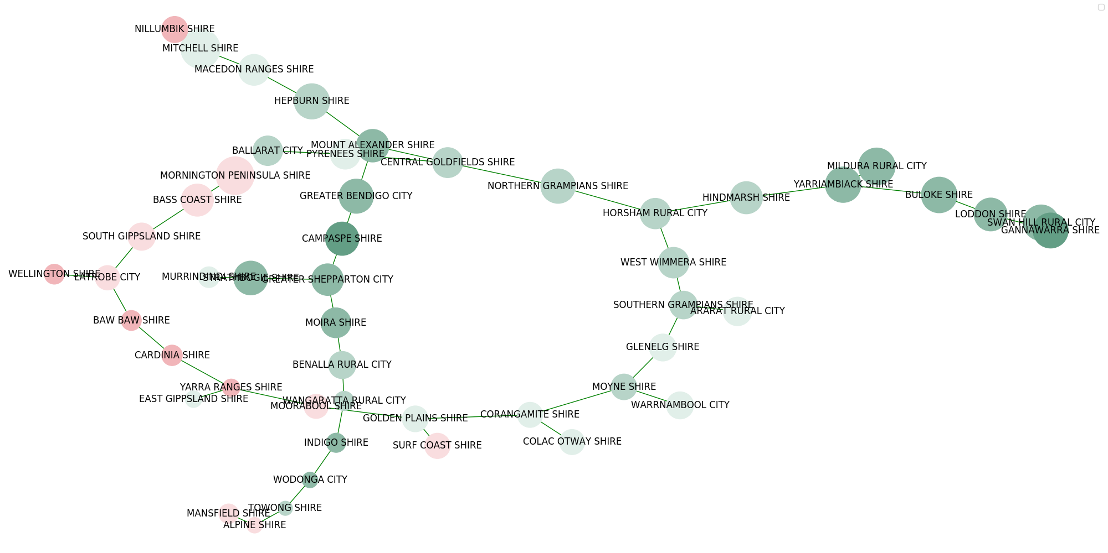
/mnt/y/Code/Analysis/graph/Graph_figures/VIC_LGA/present/season/size_prod_color_VF_time_2016_2.png

Slide 44
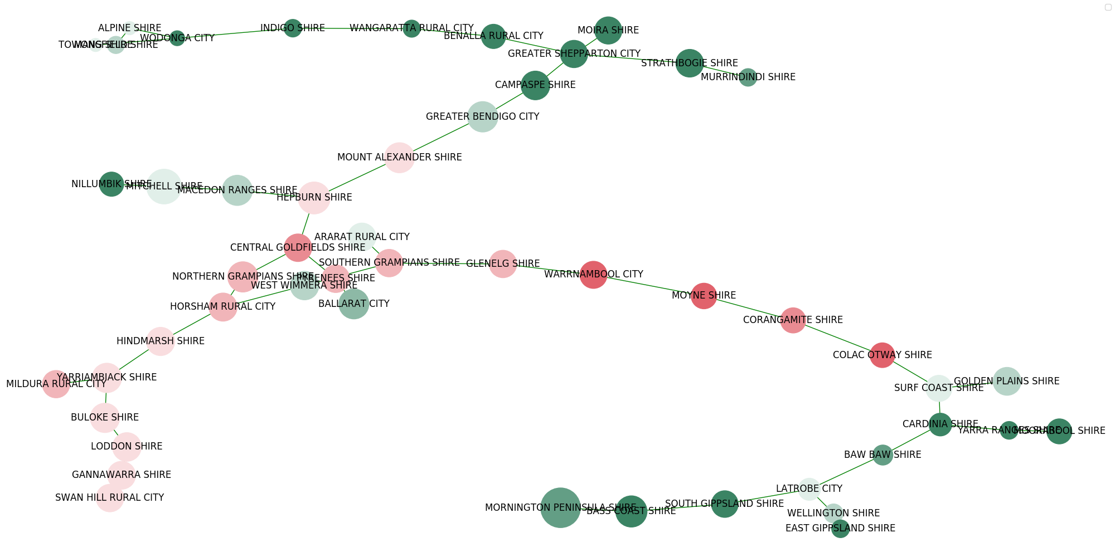
/mnt/y/Code/Analysis/graph/Graph_figures/VIC_LGA/present/season/size_prod_color_VF_time_2016_3.png

Slide 45
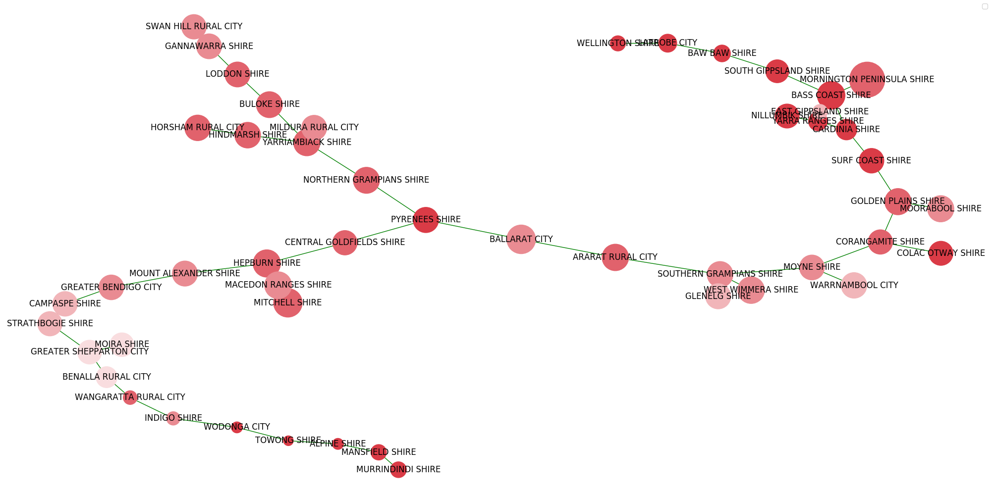
/mnt/y/Code/Analysis/graph/Graph_figures/VIC_LGA/present/season/size_prod_color_VF_time_2016_4.png

Slide 46
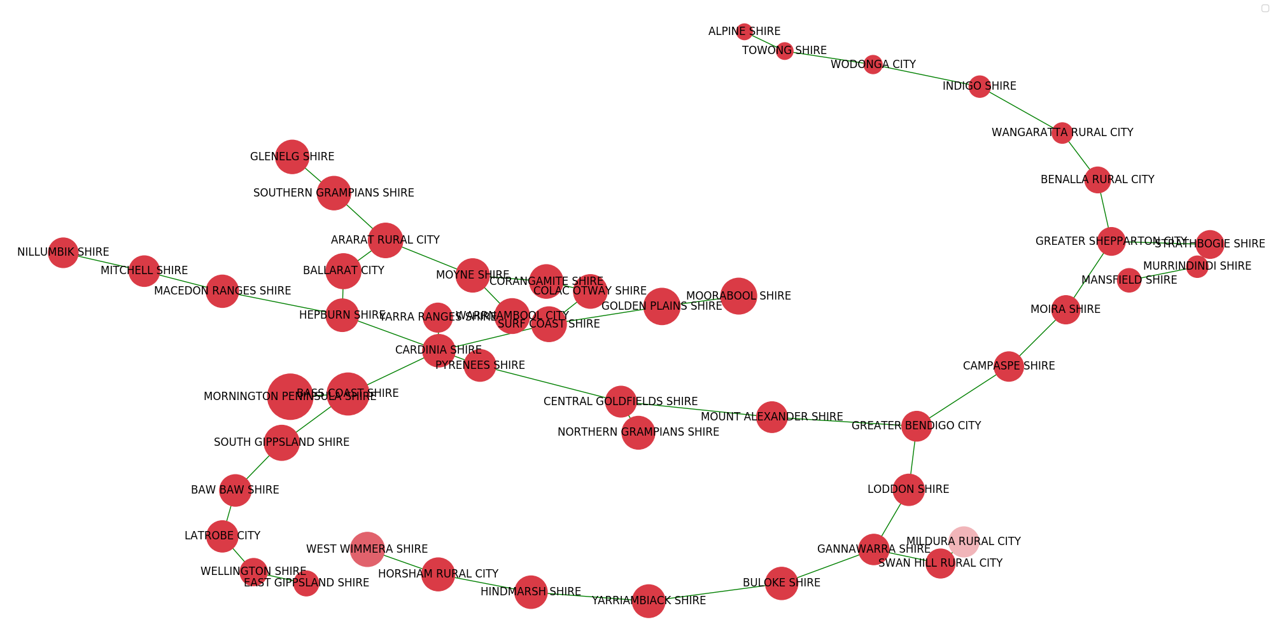
/mnt/y/Code/Analysis/graph/Graph_figures/VIC_LGA/present/season/size_prod_color_VF_time_2016_5.png

Slide 47
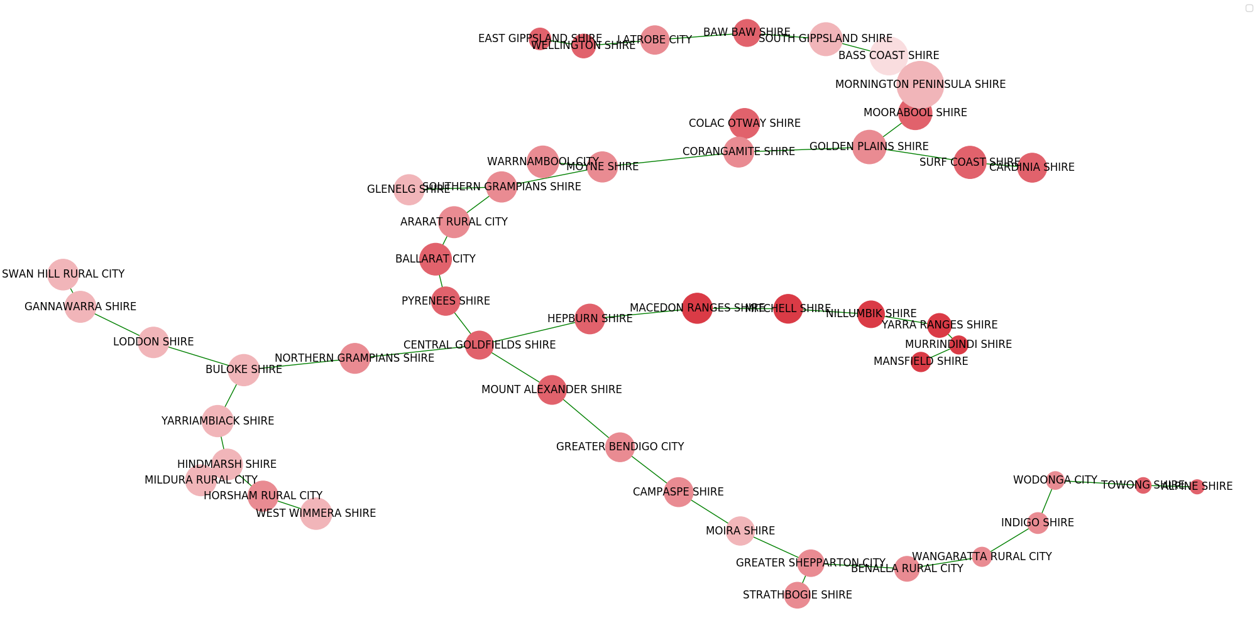
/mnt/y/Code/Analysis/graph/Graph_figures/VIC_LGA/present/season/size_prod_color_VF_time_2016_6.png

Slide 48
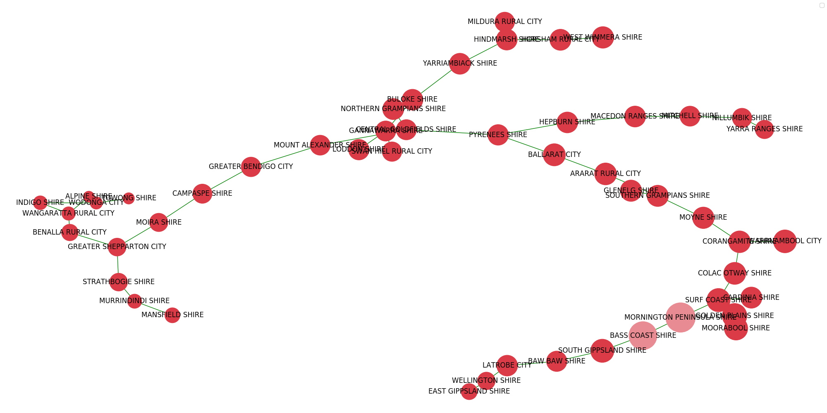
/mnt/y/Code/Analysis/graph/Graph_figures/VIC_LGA/present/season/size_prod_color_VF_time_2016_7.png

Slide 49
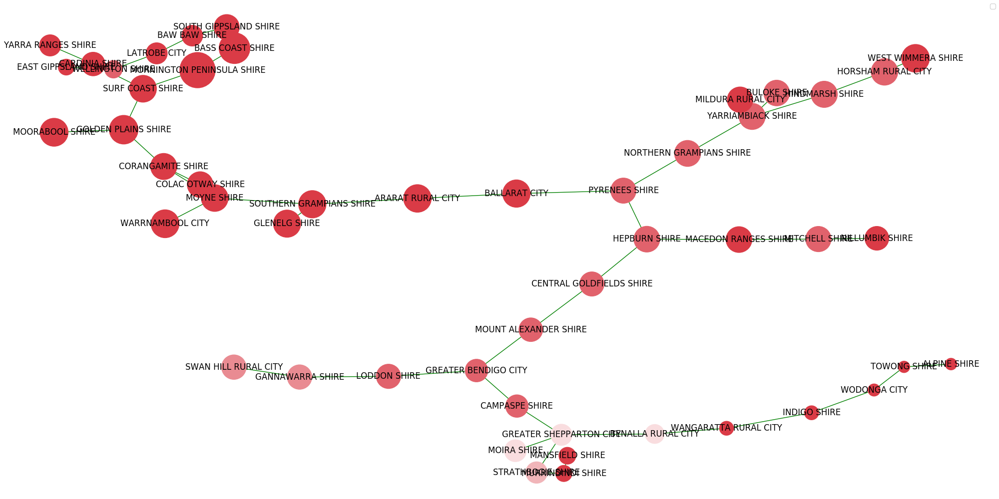
/mnt/y/Code/Analysis/graph/Graph_figures/VIC_LGA/present/season/size_prod_color_VF_time_2016_8.png

Slide 50
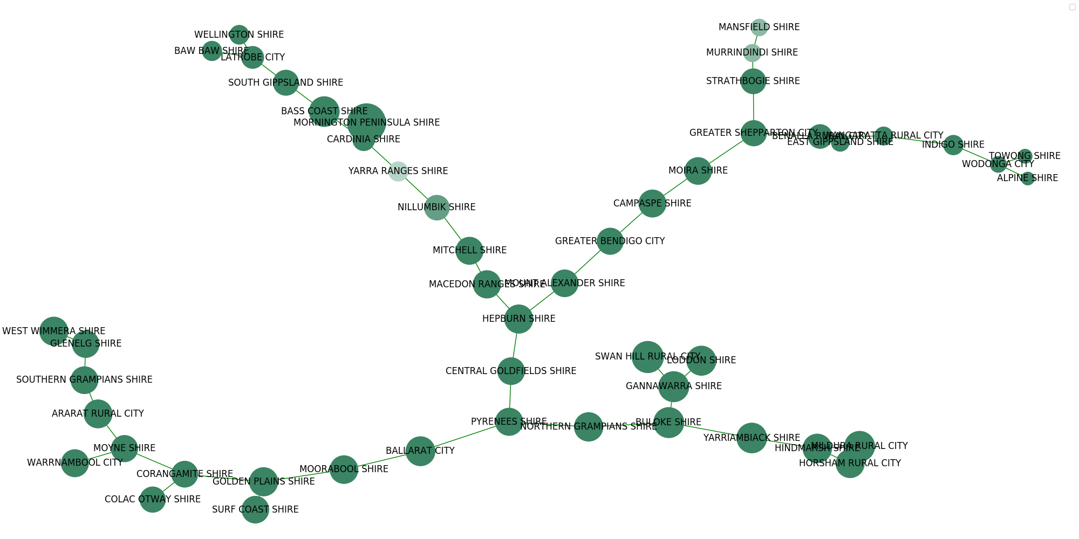
/mnt/y/Code/Analysis/graph/Graph_figures/VIC_LGA/present/season/size_prod_color_VF_time_2016_9.png

Slide 51
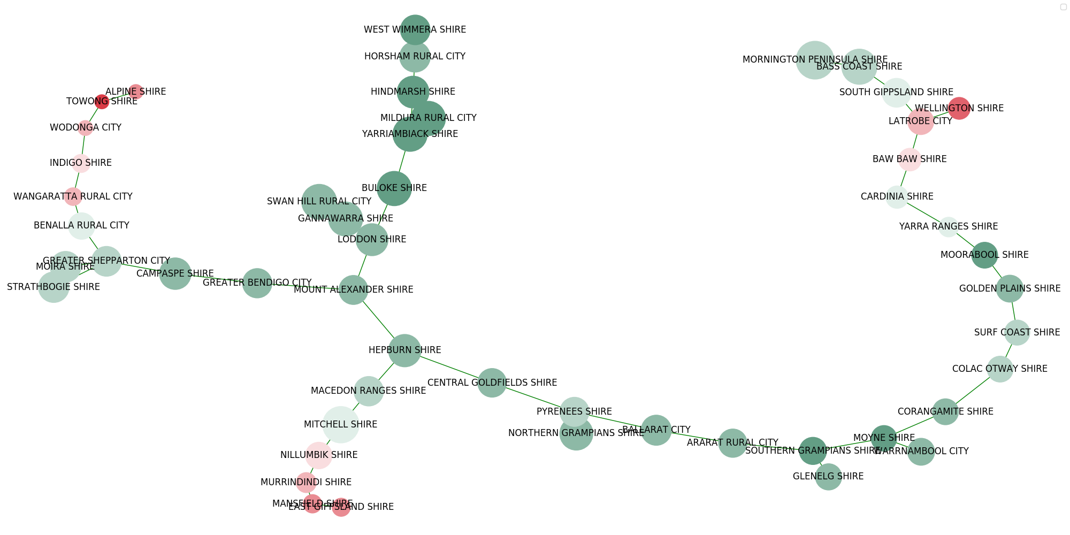
/mnt/y/Code/Analysis/graph/Graph_figures/VIC_LGA/present/season/size_prod_color_VF_time_2017_1.png

Slide 52

/mnt/y/Code/Analysis/graph/Graph_figures/VIC_LGA/present/season/size_prod_color_VF_time_2017_10.png

Slide 53

/mnt/y/Code/Analysis/graph/Graph_figures/VIC_LGA/present/season/size_prod_color_VF_time_2017_11.png

Slide 54

/mnt/y/Code/Analysis/graph/Graph_figures/VIC_LGA/present/season/size_prod_color_VF_time_2017_12.png

Slide 55

/mnt/y/Code/Analysis/graph/Graph_figures/VIC_LGA/present/season/size_prod_color_VF_time_2017_2.png

Slide 56

/mnt/y/Code/Analysis/graph/Graph_figures/VIC_LGA/present/season/size_prod_color_VF_time_2017_3.png

Slide 57

/mnt/y/Code/Analysis/graph/Graph_figures/VIC_LGA/present/season/size_prod_color_VF_time_2017_4.png

Slide 58

/mnt/y/Code/Analysis/graph/Graph_figures/VIC_LGA/present/season/size_prod_color_VF_time_2017_5.png

Slide 59

/mnt/y/Code/Analysis/graph/Graph_figures/VIC_LGA/present/season/size_prod_color_VF_time_2017_6.png

Slide 60

/mnt/y/Code/Analysis/graph/Graph_figures/VIC_LGA/present/season/size_prod_color_VF_time_2017_7.png

Slide 61

/mnt/y/Code/Analysis/graph/Graph_figures/VIC_LGA/present/season/size_prod_color_VF_time_2017_8.png

Slide 62

/mnt/y/Code/Analysis/graph/Graph_figures/VIC_LGA/present/season/size_prod_color_VF_time_2017_9.png

